Slide 1
Mockup site Html
Sistemas de Informação II
José Faria | Armindo Barbosa
João Gonçalves | up201707323

Slide 2
Structure and Context
This mockup is about the European League of Legends scene

Slide 3
Mockups inciais

Slide 5
Cores
Hexadicimal: #050019
Navigation bar
Hexadecimal: #ff5117
Navigation bar
Hexadecimal #262626
Background
Hexadecimal: #00E5BF
Navigation bar
Hexadecimal: #ffffff
Text

Slide 6
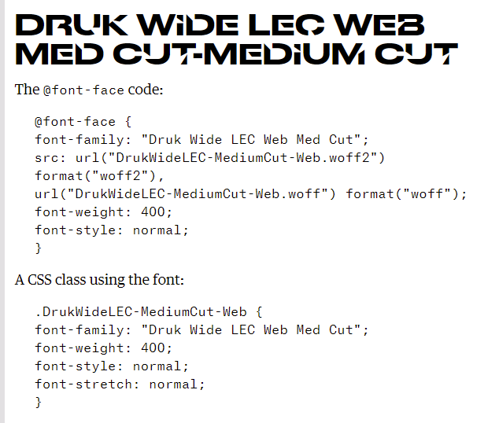
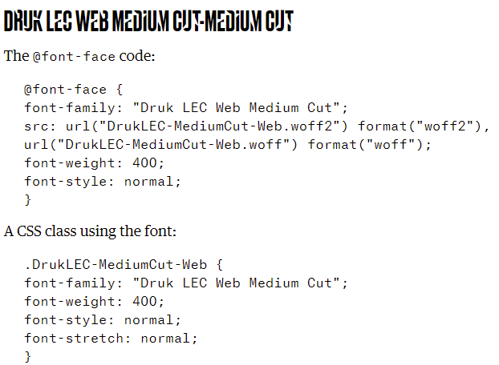
Tipografia
Arial

Slide 7
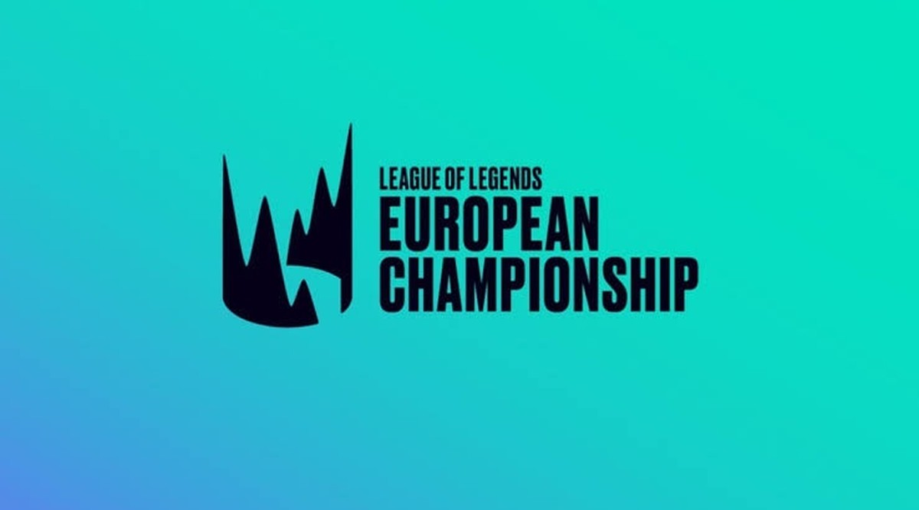
 | Schedule | Legendary Players | Legendary Teams | On Air Talent | Worlds | Story of The League | About me
182 px
Teams
Standings
Schedule
Wall of Champions
30px
Height:90px
Width: 100%
Hover: Fica mais claro
Clicar letra fica azul do simbolo
fixo
Auto

Slide 8
 | Schedule | Legendary Players | Legendary Teams | On Air Talent | Worlds | Story of The League | About me
Height: 250px
square
Imagem interior height:200px square
30px
80px desde a imagem acima
Padding
30 px
40px
Clicar em qualquer equipa levará à pag. Da equipa
300px

Slide 9
 | Schedule | Legendary Players | Legendary Teams | On Air Talent | Worlds | Story of The League | About me
Imagem 90px square
SERÁ EM DRUK (LETRA OFICIAL DO LEC
CURRENT STANDINGS
50 px
1 |  | Rogue | 11W-2L
2 |  | G2 | 11W-2L
3 |  | SK Gaming | 8W-5L
5 |  | MAD Lions | 8W-5L
5 |  | Fnatic | 7W-6L
6 |  | Excel | 5W-8L
7 |  | Misfits Gaming | 5W-8L
8 |  | Schalke 04 | 5W-8L
9 |  | Astralis | 3W-10L
10 |  | Team Vitality | 2W-11L
100px
100 px
750 px
300 px
200 px

Slide 10
 | Schedule | Legendary Players | Legendary Teams | On Air Talent | Worlds | Story of The League | About me
WALL OF CHAMPIONS
Ao clicar na equipa vencedora irá para a pagina da equipa
20 px
150 px
50 px
Eu LCS | LEC
200 px
50 px
250 px
Spring
2013
Spring
2014
Spring
2015
Spring
2016
Spring
2017
Spring
2018
30 px
80 px
80 px
100 px
Summer
2013
Summer
2014
Summer
2015
Summer
2016
Summer
2017
Summer
2018

Slide 11
 | Schedule | Legendary Players | Legendary Teams | On Air Talent | Worlds | Story of The League | About me
Eu LCS | LEC
100 px
50 do centro para cada um
Spring
2019
Spring
2020
Summer
2019
Summer
2020

Slide 12
Template Pagina de equipa

Slide 13
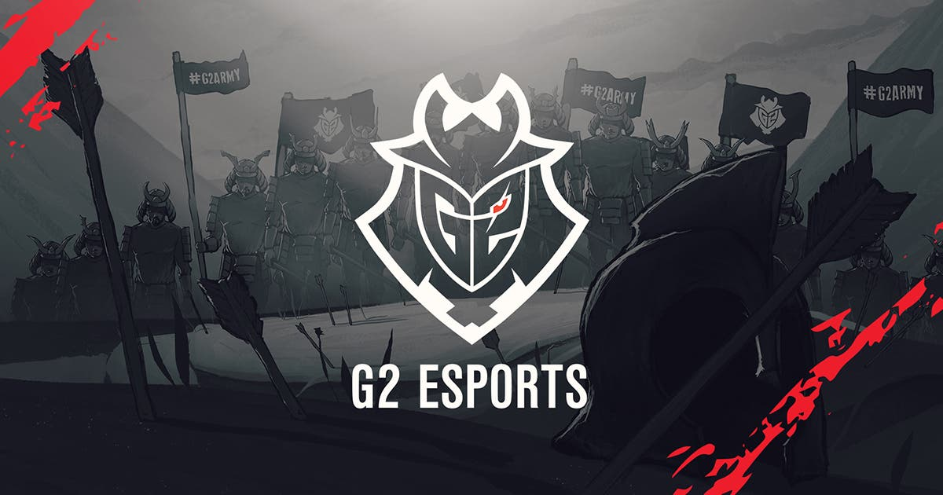
 | Schedule | Legendary Players | Legendary Teams | On Air Talent | Worlds | Story of The League | About me
Fill page, auto the image

Slide 14
 | Schedule | Legendary Players | Legendary Teams | On Air Talent | Worlds | Story of The League | About me
80 px
G2 Esports
https://g2esports.com/?r=EU
G2 Esports (commonly shortened to just G2 and formerly known as Gamers2) is a European esports organization headquartered in Berlin, Germany, with players competing in League of Legends, Valorant, Counter-Strike: Global Offensive, Hearthstone, Rocket League, Rainbow Six Siege, and iRacing. The organization was founded on 24 February 2014 as Gamers2 by former League of Legends pro Carlos "Ocelote" Rodríguez Santiago and investor Jens Hilgers. The organization rebranded as G2 Esports on 15 October 2015.
G2's League of Legends team competes in the League of Legends European Championship (LEC), the highest level of competitive League of Legends in Europe. The team won the 2016 Spring, 2016 Summer, 2017 Spring, and 2017 Summer EU LCS, the 2019 Spring LEC, the 2019 Mid-Season Invitational, the 2019 Summer LEC, the 2020 Spring LEC and the 2020 Summer LEC.
100 px
Padding
300 px
80 px
Druk

Slide 15
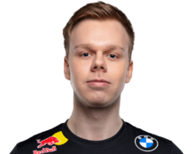
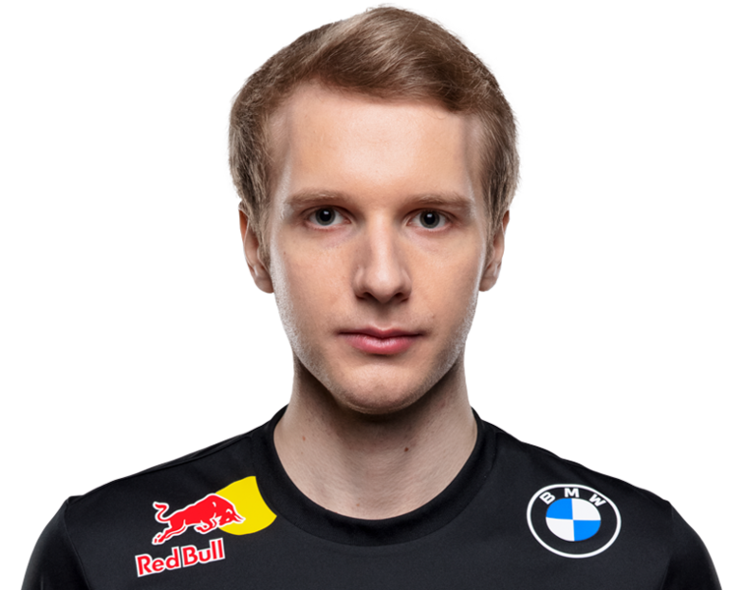
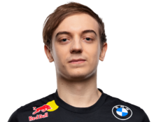
 | Schedule | Legendary Players | Legendary Teams | On Air Talent | Worlds | Story of The League | About me
350 px
100 px
TOP
JUNGLE
MID
100 px
150 px
450 px
300 px
MARTIN HANSEN
Wunder
MARCIN JANKOWSKI
Jankos
RAMMUS WINTHER
Caps
100 px

Slide 16
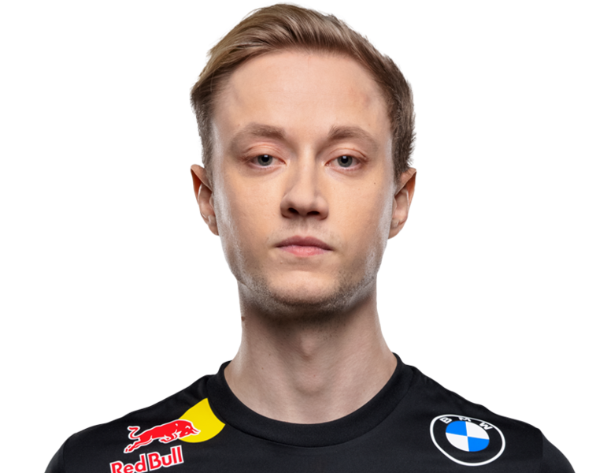
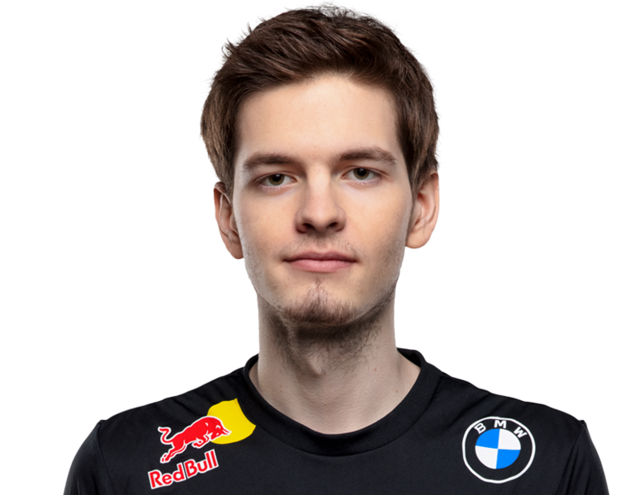
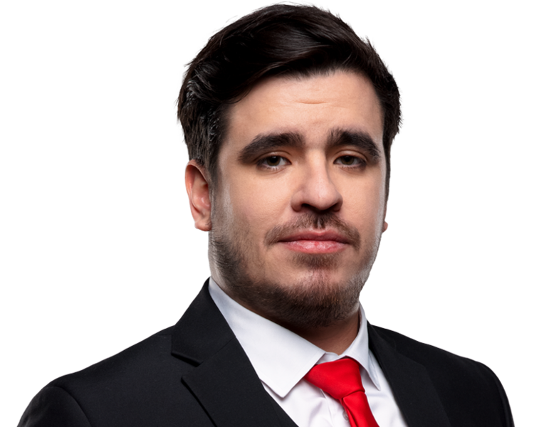
 | Schedule | Legendary Players | Legendary Teams | On Air Talent | Worlds | Story of The League | About me
BOT
SUPPORT
COACH
MARTIN LARSSON
Rekkles
MIHAEL MEHLE
Mikyx
FABIAN LOHMANN
GrabbZ

Slide 17
Template se clicar na equipa vencedor

Slide 18
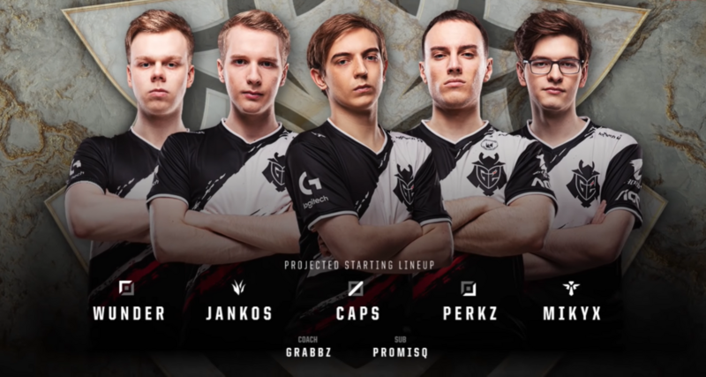
 | Schedule | Legendary Players | Legendary Teams | On Air Talent | Worlds | Story of The League | About me
400 px
2019 SUMMER SPLIT WINNERS
G2 ESPORTS
Druk
1000px
Center
Auto

Slide 19
 | Schedule | Legendary Players | Legendary Teams | On Air Talent | Worlds | Story of The League | About me
250 px
TEAMS STANDINGS
Team |  | Place Playoff | Place Regular Season
G2 |  | 1st | 1st
Fnatic |  | 2nd | 2nd
Schalke 04 |  | 3rd | 4th
Rogue |  | 4th | 5th
Splyce |  | 5/6th | 3rd
Team Vitality |  | 5/6th | 6th
SK Gaming |  | - | 7th
Origen |  | - | 8th
Misfits Gaming |  | - | 9th
Excel |  | - | 10th
150 px
Centrar tabela
100 px
500 px
250 px
250 px

Slide 20
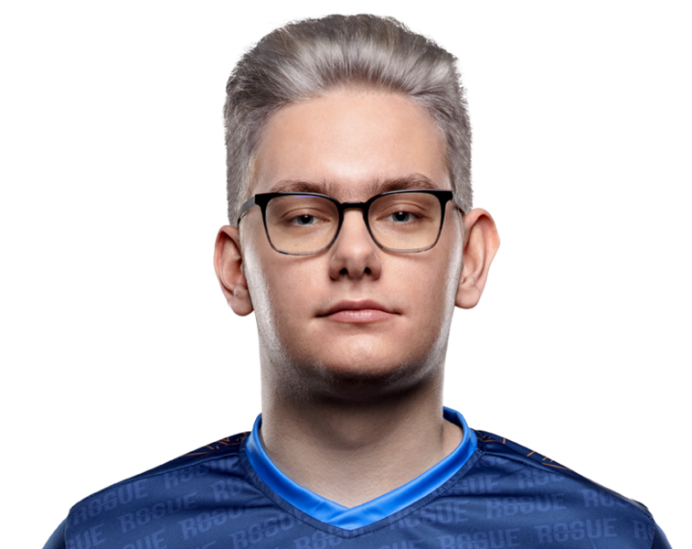
 | Schedule | Legendary Players | Legendary Teams | On Air Talent | Worlds | Story of The League | About me
150 px
MVP
Outstanding Rookie
BEST COACH
MARCIN JANKOWSKI
Jankos
KACPER SLOMA
Inspired
FABIAN LOHMANN
GrabbZ

Slide 21
Se for summer split acrescenta a informação das equipas que foram aos worlds

Slide 22
 | Schedule | Legendary Players | Legendary Teams | On Air Talent | Worlds | Story of The League | About me
200 px
League of Legends World Championship
Season 9
EU teams
druk
150 px

Slide 23
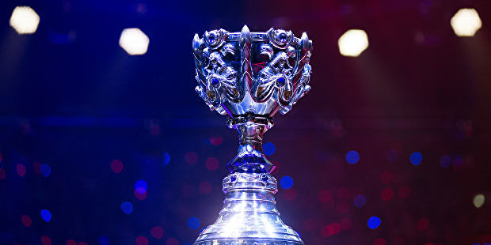
 | Schedule | Legendary Players | Legendary Teams | On Air Talent | Worlds | Story of The League | About me
Transparencia a 50%
SEED | Team |  | TOP | JUNGLE | MID | BOT | SUPPORT
1 | G2 |  | Wunder | Jankos | Caps | Perkz | Mikyx
2 | FNATIC |  | Bwipo | Broxah | Nemesis | Rekkles | Hylissang
3 | SPLYCE |  | Vizicsacsi | Xerxe | Humanoid | Kobbe | Norsekeren
200px
150 px
100 px
175 px
250 px
200 px

Slide 24
 | Schedule | Legendary Players | Legendary Teams | On Air Talent | Worlds | Story of The League | About me
WEEK 7
Escolher semana e dia
Imagem
Height: 170 px
Leva à stream
200 px
Day 1
300 px
250 px
Se o jogo já tiver sido jogado aparecerá link para o Youtube
5th March
17h00 | MAD Lions | vs | Schalke 04
18h00 | Astralis | vs | Misfits Gaming
19h00 | G2 Esports | vs | Rogue
20h00 | SK Gaming | vs | Team Vitality
21h00 | Excel | vs | Fnatic
Centrar tabela
150 px
Imagem
Heigth 130
square
*Time in GMT
700 px

Slide 25
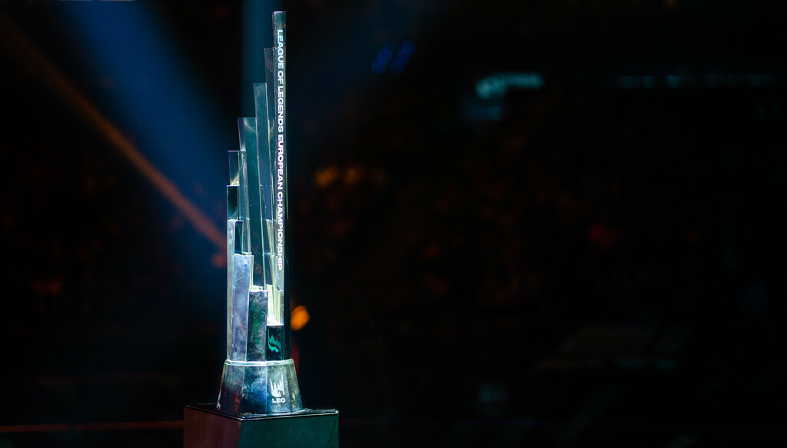
 | Schedule | Legendary Players | Legendary Teams | On Air Talent | Worlds | Story of The League | About me
Será em druk
GOATS OF
EUROPE

Slide 26
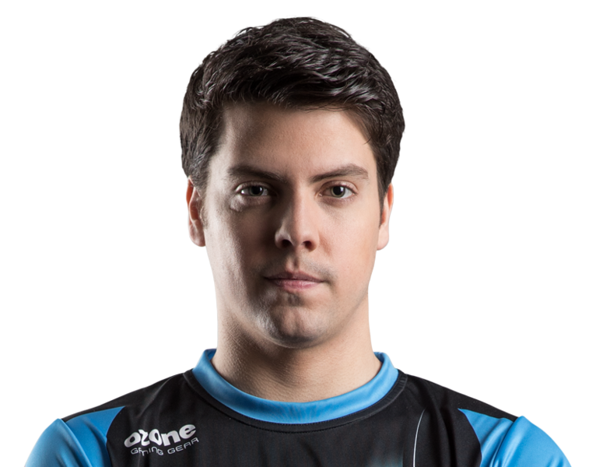
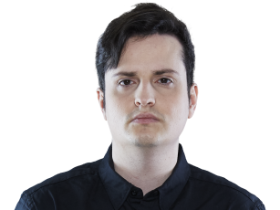
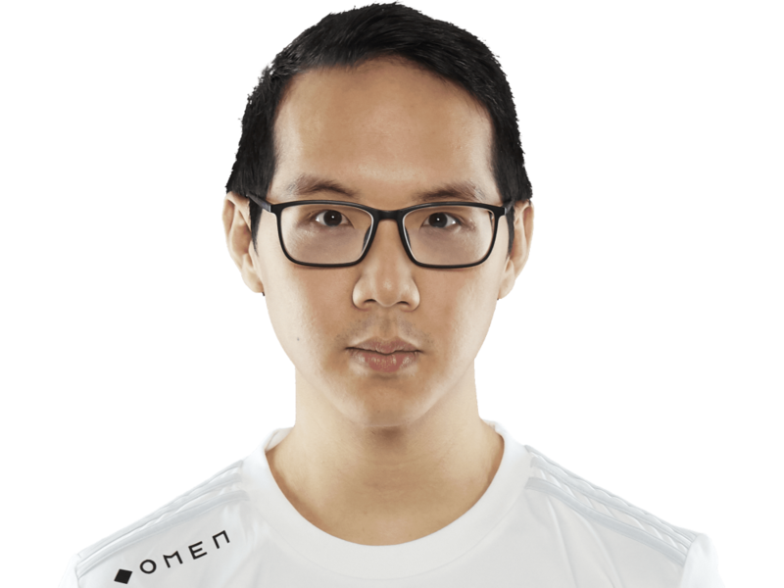
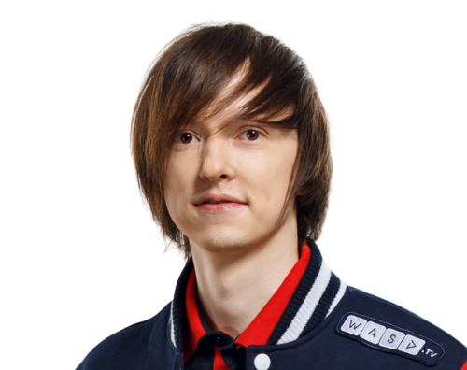
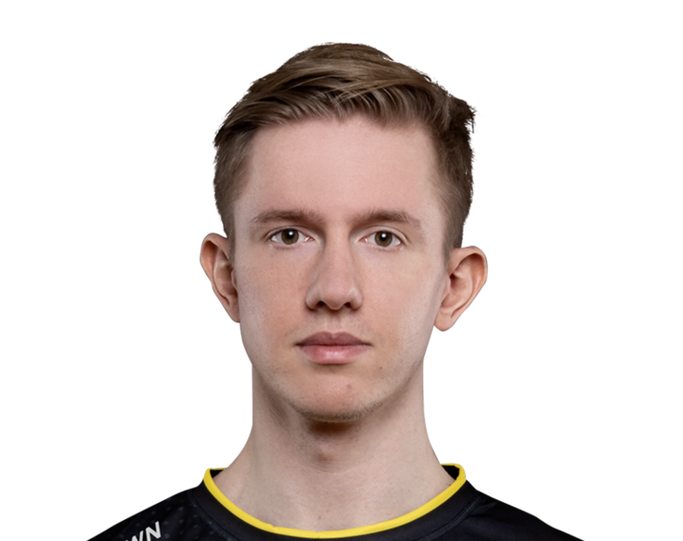
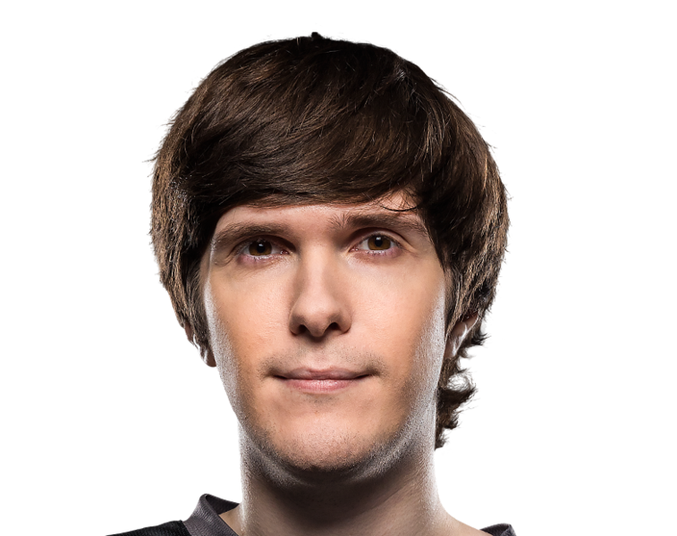
 | Schedule | Legendary Players | Legendary Teams | On Air Talent | Worlds | Story of The League | About me
200 px
Centrar imagem do meio
400 px
auto
250 px
200 px
200 px

Slide 27
 | Schedule | Legendary Players | Legendary Teams | On Air Talent | Worlds | Story of The League | About me
Enrique Cedeño Martínez
xPeke
Hover
Ao clicar vai para pagina do jogador
*haverá mais Jogadores

Slide 28
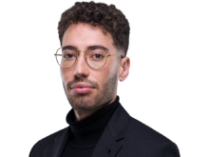
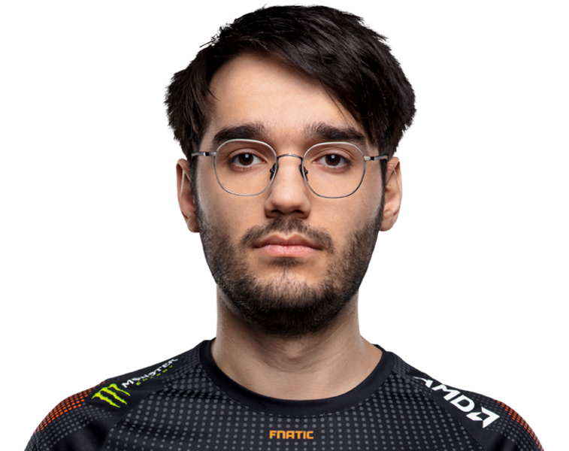
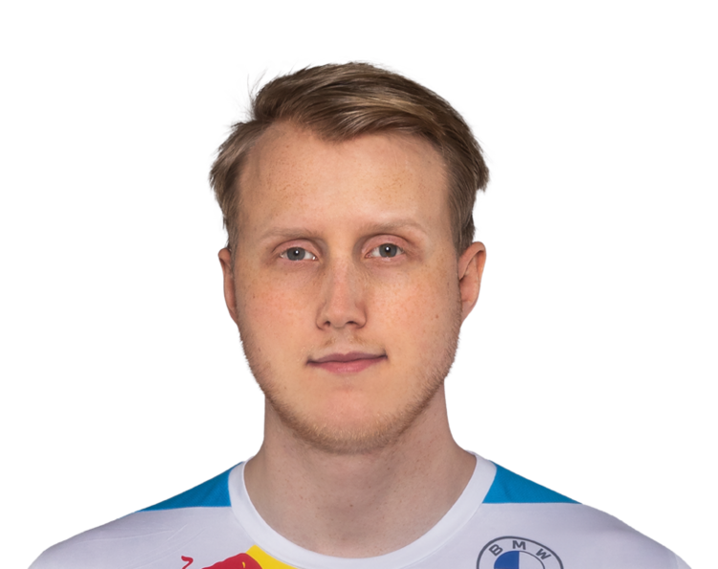
 | Schedule | Legendary Players | Legendary Teams | On Air Talent | Worlds | Story of The League | About me

Slide 29
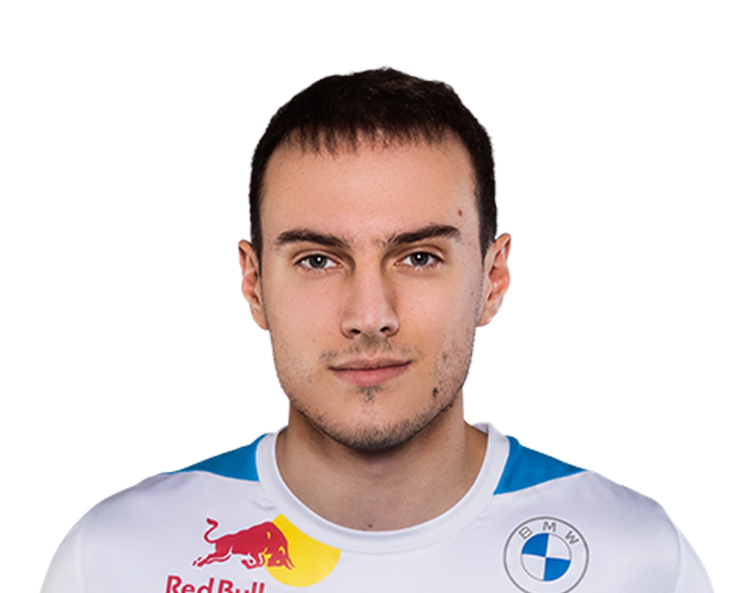
 | Schedule | Legendary Players | Legendary Teams | On Air Talent | Worlds | Story of The League | About me

Slide 30
 | Schedule | Legendary Players | Legendary Teams | On Air Talent | Worlds | Story of The League | About me
450 px
Past teams
250 px
Fnatic | Mar 2011 | Dec 2014
Origen | Dec 2014 | Sep 2020
Astralis | Sep 2020 | Present
100 px
Enrique Cedeño Martinez (born 24 April 1992), better known by his in-game name xPeke, is a retired professional League of Legends player. He was the founder and owner of Origen, which competed in the LEC, the top level of professional League of Legends in Europe. He is currently a shareholder for Astralis. Martinez is best known for his spell with Fnatic, with whom he has won three League of Legends Championship Series Europe titles and the Season 1 World Championship.
Enrique Cedeño Martínez
xPeke

Slide 31
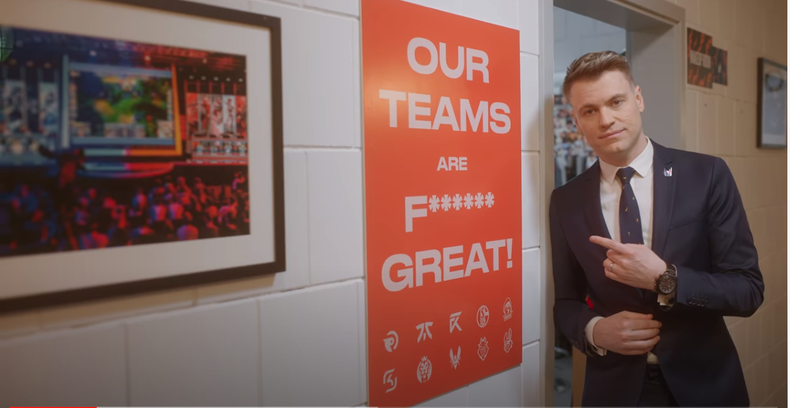
 | Schedule | Legendary Players | Legendary Teams | On Air Talent | Worlds | Story of The League | About me

Slide 32
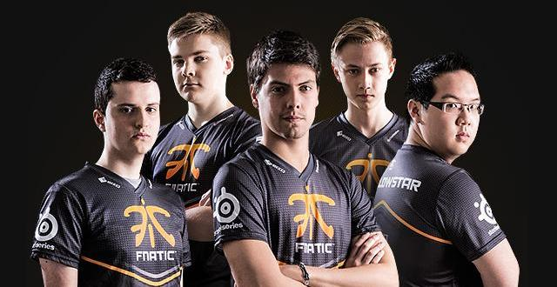
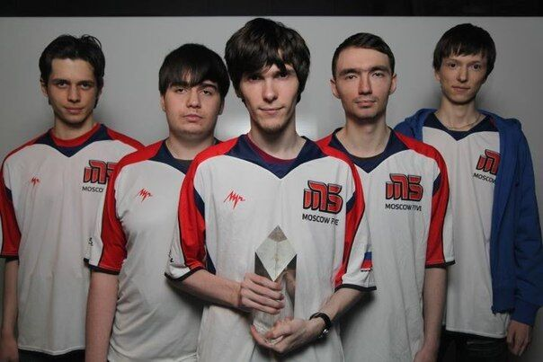
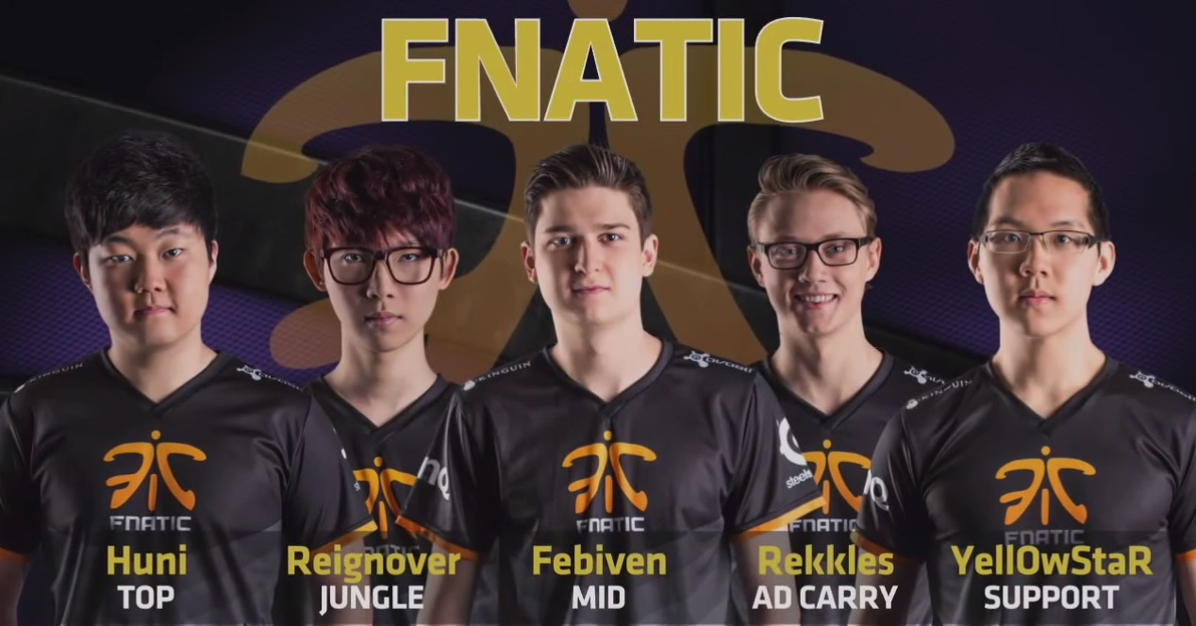
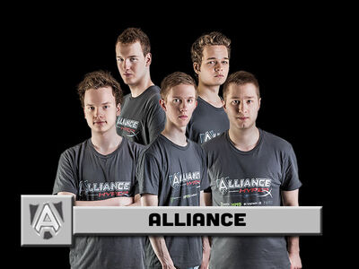
 | Schedule | Legendary Players | Legendary Teams | On Air Talent | Worlds | Story of The League | About me
450 px
auto
100 px
200 px
100 px
200 px
100 px

Slide 33
 | Schedule | Legendary Players | Legendary Teams | On Air Talent | Worlds | Story of The League | About me
2015 Summer split Fnatic

Slide 34
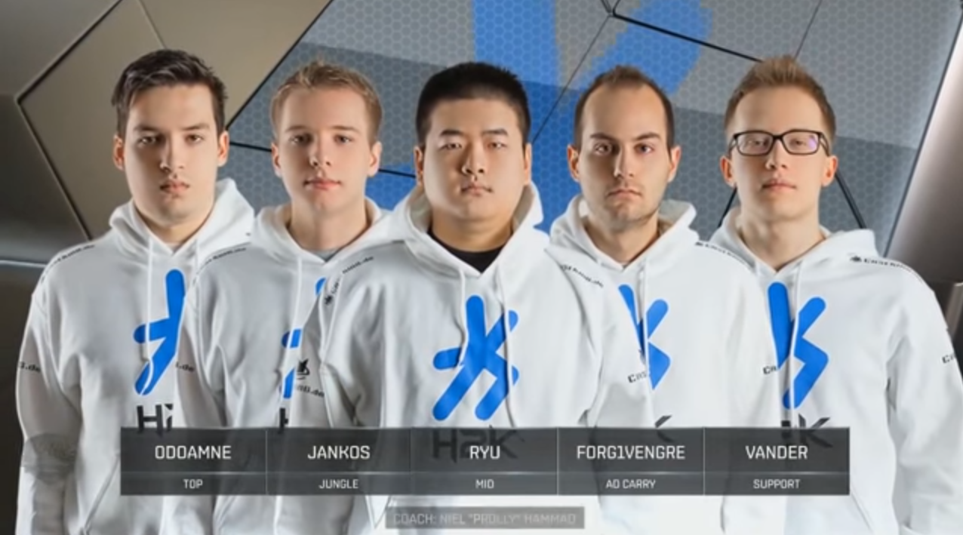
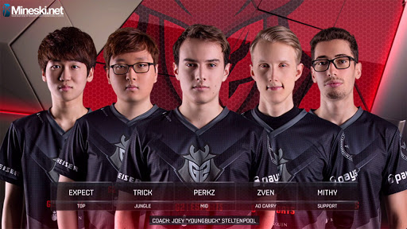
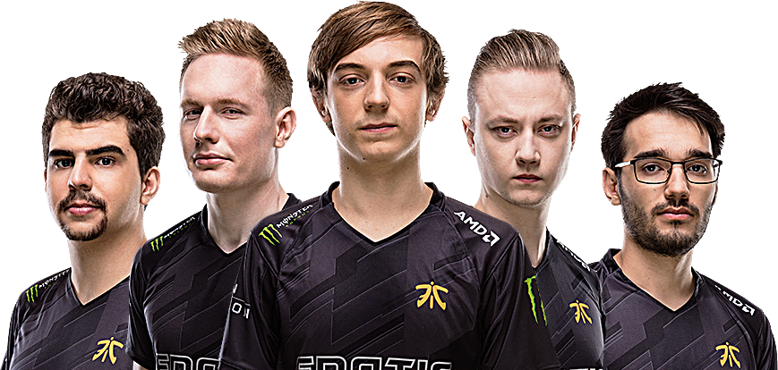
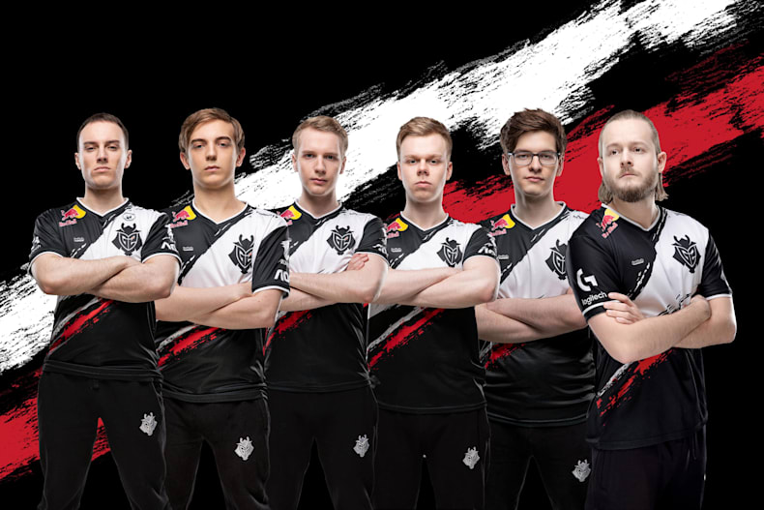
 | Schedule | Legendary Players | Legendary Teams | On Air Talent | Worlds | Story of The League | About me

Slide 35
TEMPLATE LEGENDARY TEAM

Slide 36
 | Schedule | Legendary Players | Legendary Teams | On Air Talent | Worlds | Story of The League | About me
300 px
500 px
This Fnatic team managed to finish the regular season with a perfect, unbeaten 18-0 record - and became the first team to achieve this in League Championship Series history. This meant a 1st place regular season finish for the team and a place in the semifinals of the Summer Playoffs. Fnatic went on to win the playoffs, beating Origen 3-2 in a tight final. This qualified the team for the 2015 World Championship, where they would compete as Europe’s 1st seed.
At the 2015 World Championship, Fnatic were seeded into Group B along with ahq e-Sports Club, Invictus Gaming, and Cloud9. They picked up four wins in the group, going unbeaten in the second week of group stage games, meaning they would advance to the knockout stage of the tournament. In the quarterfinals, Fnatic beat EDward Gaming 3-0 before suffering a 3-0 loss to KOO Tigers in the semifinals, putting an end to their campaign.
100 px

Slide 37
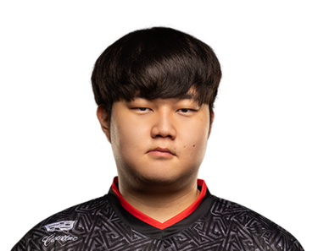
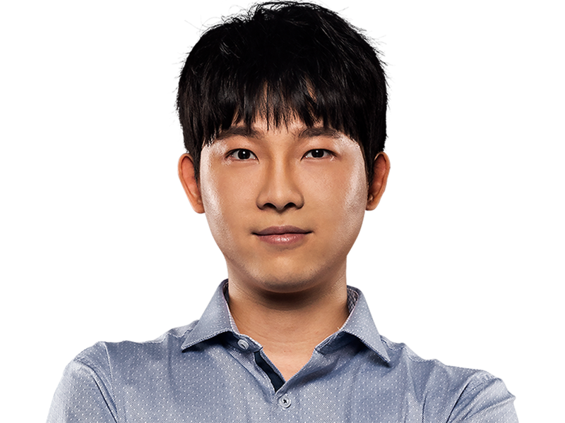
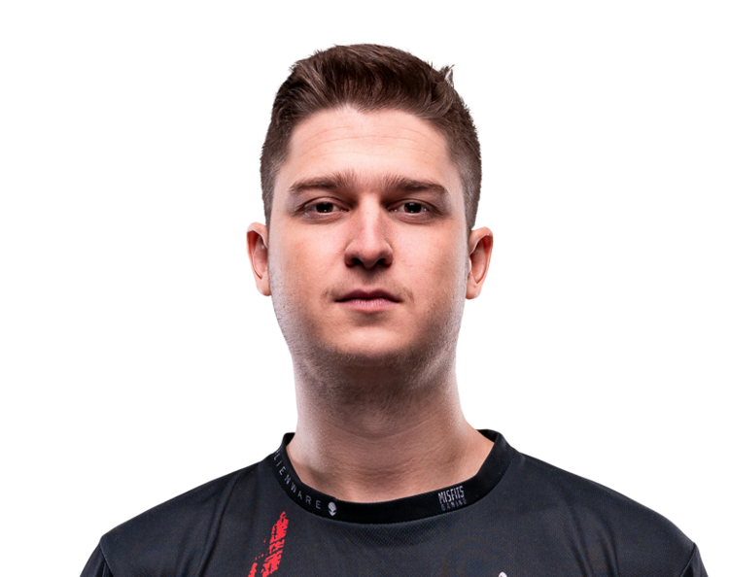
 | Schedule | Legendary Players | Legendary Teams | On Air Talent | Worlds | Story of The League | About me
200 px
TOP | JUNGLE | MID | BOT | SUPPORT
Heo Seung-hoon Huni | Kim Yeu-jin Reignover | Fabian Diepstraten Febiven | Martin Larsson Rekkles | Bora Kim Yellowstar
200 px
250 px
150 px
Clicar no jogador leva à pagina leaguepedia dele

Slide 38
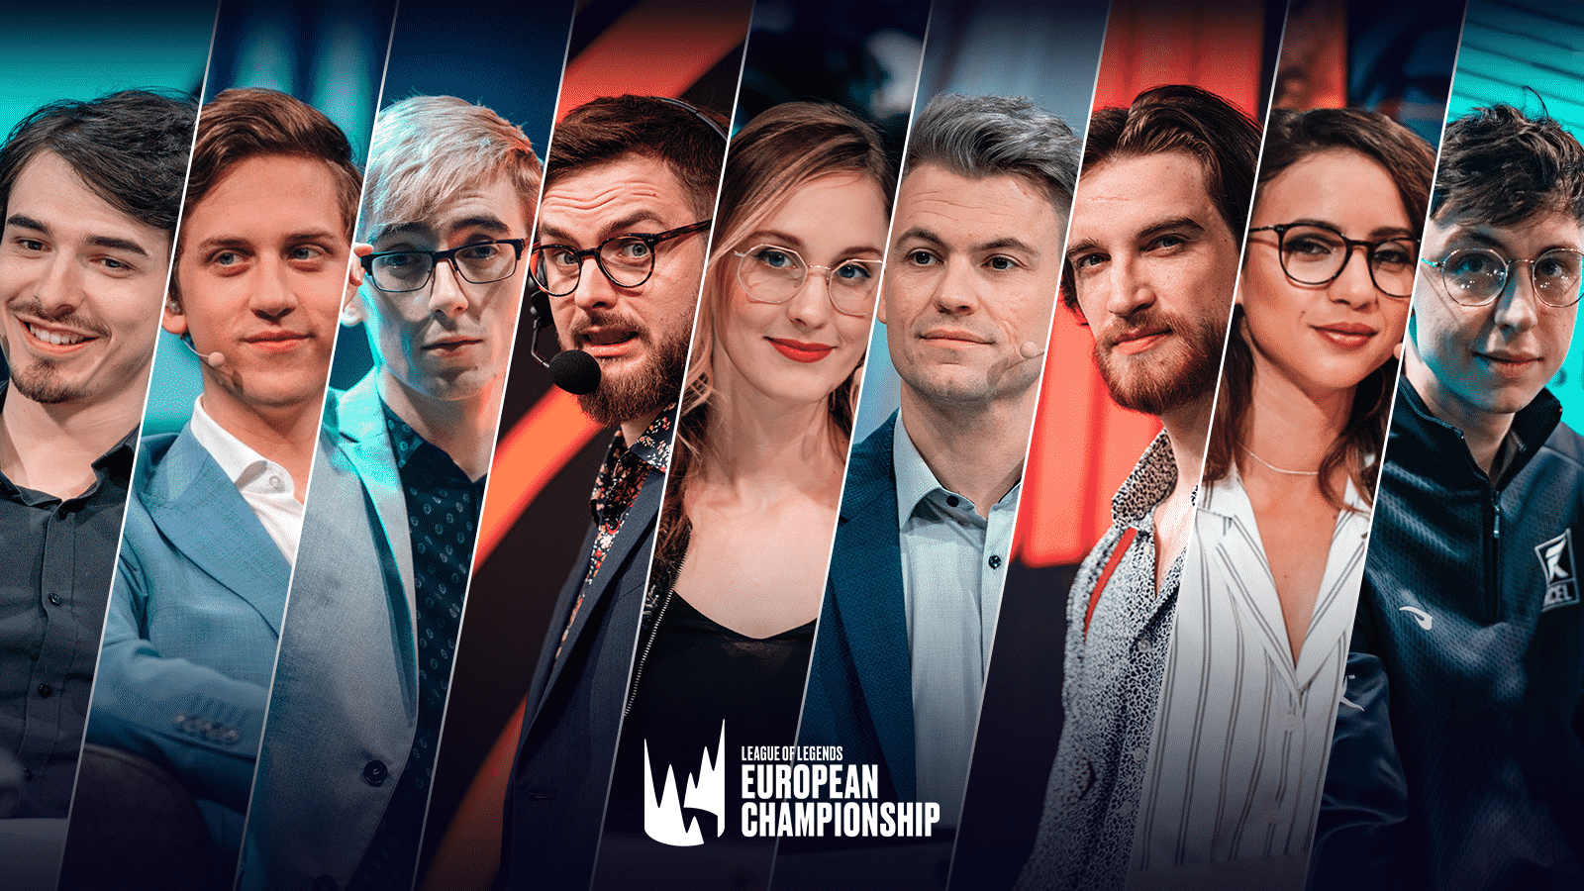
 | Schedule | Legendary Players | Legendary Teams | On Air Talent | Worlds | Story of The League | About me

Slide 39
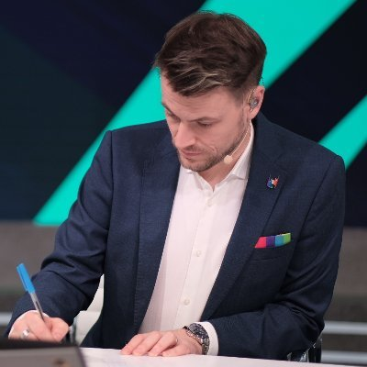
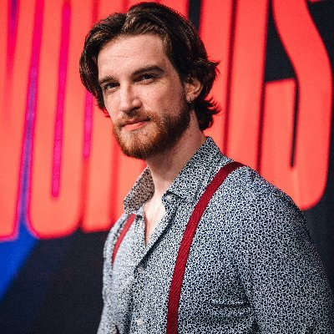
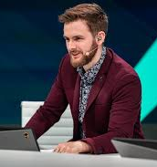
 | Schedule | Legendary Players | Legendary Teams | On Air Talent | Worlds | Story of The League | About me
Play-By-Play Caster
The PBP Caster is responsible for calling all the action in-game. The literal what is happening on screen. Their primary goals are to drive energy and hype during the match while relaying key information to the audience.
300 px
300 px auto
100 px
150 px
Trevor Henry
@Quickshot
Quickshot
Aaron Chamberlain
@MedicCasts
Medic
Daniel Drakos
@DanielDrakos
Drakos
250 px

Slide 40
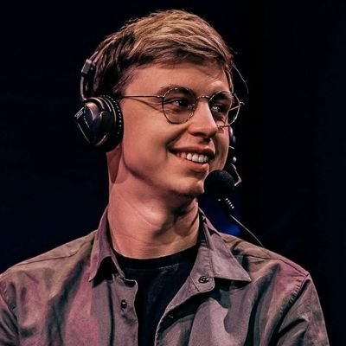
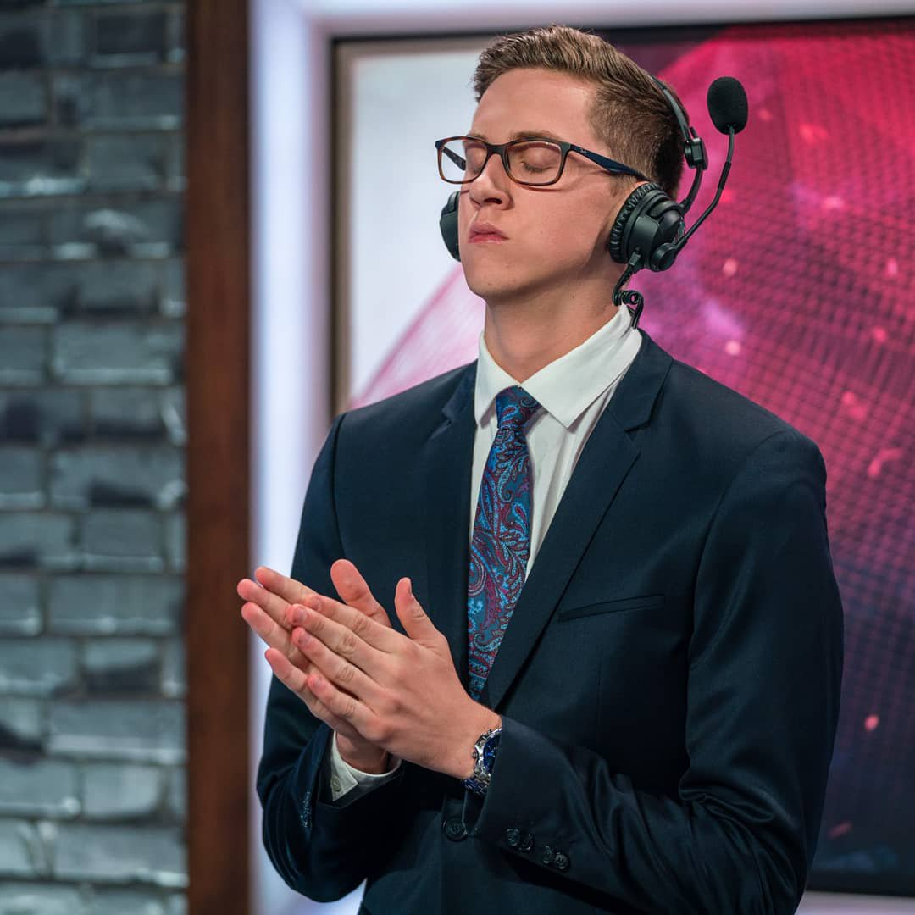
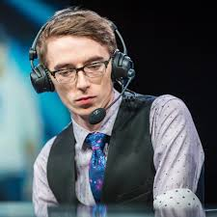
 | Schedule | Legendary Players | Legendary Teams | On Air Talent | Worlds | Story of The League | About me
Color Caster
The Colour Caster is responsible for giving a professional, informed, and expert opinion on the match. These casters explain why things are happening. Their goals are less to do with information relay and more focused on expanding pin-point analysis.
Marc Robert Lamont
@Caedrel
Caedrel
Christy Frierson
@endercasts
Ender
Andrew Day
@RiotVedius
Vedius

Slide 41
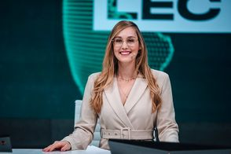
 | Schedule | Legendary Players | Legendary Teams | On Air Talent | Worlds | Story of The League | About me
Analysis Host
300 px
O Twitter levará ao Twitter e clicar nafoto ao leaguepedia das mesmas
center
400 px
Eefje Depoortere
@sjokz
Sjokz
200px

Slide 42
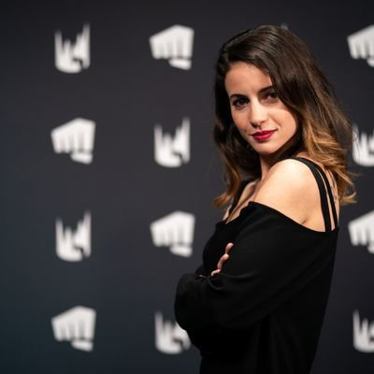
 | Schedule | Legendary Players | Legendary Teams | On Air Talent | Worlds | Story of The League | About me
Interviewer
Laure Valée
@LaureBuliiV
Bulii

Slide 43
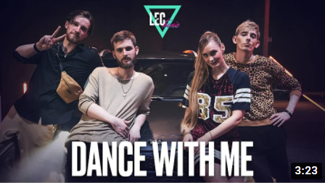
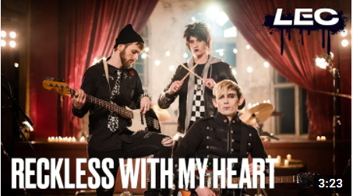
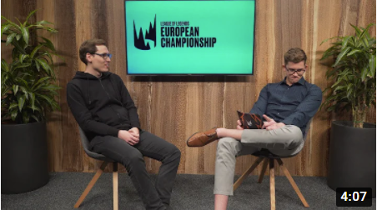
 | Schedule | Legendary Players | Legendary Teams | On Air Talent | Worlds | Story of The League | About me
Será uma compilação de vídeos criados pelo lec
200 px
https://www.youtube.com/playlist?list=PLyQvIOxTaHdSYEqGXdMDJ906wGKnzLeOI
https://www.youtube.com/playlist?list=PLyQvIOxTaHdQi9b3_nB8zfFtPphmihmH_

Slide 44
 | Schedule | Legendary Players | Legendary Teams | On Air Talent | Worlds | Story of The League | About me
Video que terá inicio quando entrar no separador

Slide 45
 | Schedule | Legendary Players | Legendary Teams | On Air Talent | Worlds | Story of The League | About me

Slide 46
 | Schedule | Legendary Players | Legendary Teams | On Air Talent | Worlds | Story of The League | About me
250 px
The League of Legends European Championship (LEC), previously known as the European League of Legends Championship Series (EU LCS), is the name of the professional League of Legends esports league run by Riot Games, in which ten teams compete. Each annual season of play is divided into two splits, spring and summer, both consisting of nine weeks of round-robin tournament play, which then conclude with play-off tournaments between the top six teams.
At the end of the season, the winner of the summer split, the team with the most championship points, and the winner of the gauntlet tournament qualify for the annual League of Legends World Championship. The LEC represents the highest level of League of Legends play in Europe.
With the exception of some touring events, all games of the LEC are played live at Riot Games' studio in Adlershof, Berlin, Germany.
Height: 150 px
Width: 300

Slide 47
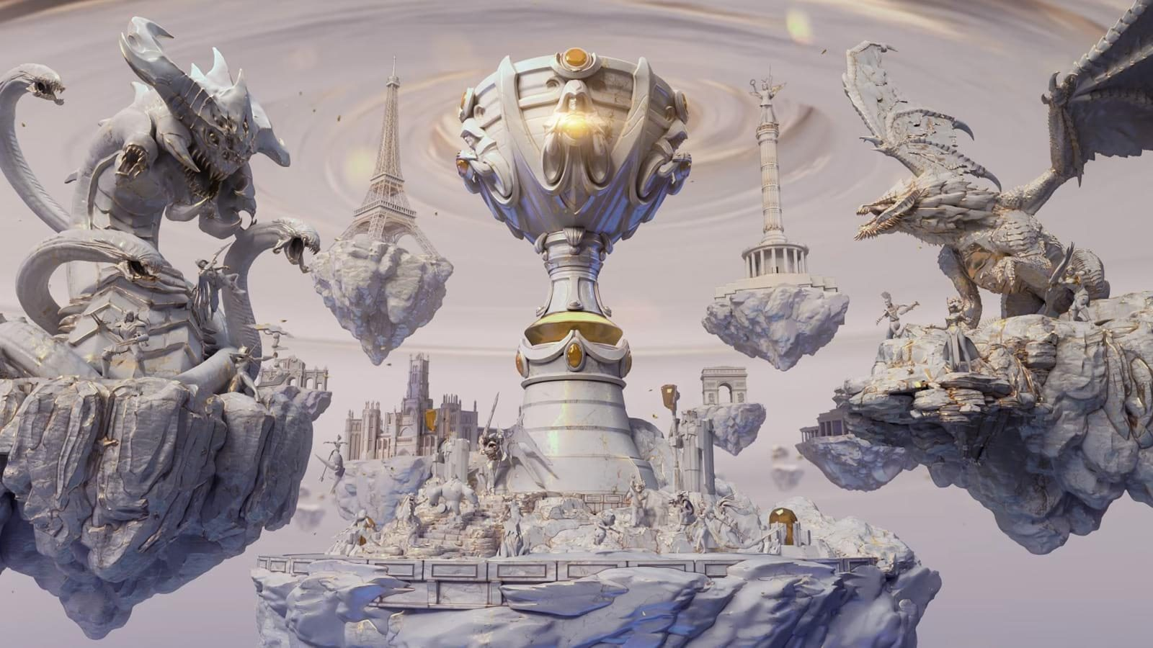
 | Schedule | Legendary Players | Legendary Teams | On Air Talent | Worlds | Story of The League | About me
Clicar símbolo leaguepedia da equipa, na season para a pagina desse mundial na wikipedia
200 px
150 px
square
SEASON 1
2011
SEASON 3
2013
SEASON 5
2015
SEASON 7
2017
SEASON 9
2019
SEASON 2
2012
SEASON 4
2014
SEASON 6
2016
SEASON 8
2018
SEASON 10
2020

Slide 48
 | Schedule | Legendary Players | Legendary Teams | On Air Talent | Worlds | Story of The League | About Me
200 px
João Gonçalves
Up201707323
Links para Download:
400 px
square
Height:200
Width:100

Slide 49
 | Schedule | Legendary Players | Legendary Teams | On Air Talent | Worlds | Story of The League | About Me
200px
250px
150 p x
Heigth::125 px
Width: 100%
© 2021 João Gonçalves. All Rights Reserved. Terms of Service Privacy Notice

