Slide 1
Software Agents: Can we Trust them?
Eugénio Oliveira
LIACC and Faculty of Engineering, University of Porto
eco@fe.up.pt
INES 2012
16th IEEE International Conference on Intelligent Engineering Systems
June 13th, 2012, Costa da Caparica, Portugal

Slide 2


ARTIFICIAL INTELLIGENCE AND COMPUTER SCIENCE LAB at UP
LIACC
Distributed AI and Robotics Group
(DAI&R / NIAD&R)
Computer Science Group
43 Researchers (21 holding PhD)
Notes:
LIACC aims at helping to solve the following general problems posed by the use of computers:
software reliability,
problems of a distributed, dynamic and decentralized nature,
security, and
information processing reliability.

Slide 3
DAI&R / NIAD&R
Main focus: Research in theoretical and practical aspects of Autonomous Agents and Multi-Agent Systems
Intelligent Robotics: Team Coordination
Text Mining: Information Extraction from media
http://paginas.fe.up.pt/~niadr/

Slide 4
OUTLINE
Main Hypothesis
Concepts
Cooperative Scenario
Competitive Scenario
My conclusion
Software Agents: Can we Trust them?
Yes, under some conditions
Agent, Multiagent Systems, Trust, Norms
Negotiating solutions
Trust under Normative Environments

Slide 5
Main Hypothesis
Research Question:
Under what conditions are Multi-Agent Systems useful and trustworthy and for what kind of problems?
Hypothesis:
MAS is the answer whenever:
    The problem is of a DDD nature
    Negotiation protocols are available
    System Environment provides monitoring mechanisms:
      Normative Environments
      Trust Models
Notes:
Triple D nature meaning that they are intrinsically Distributed, Decentralized (which is different) as well as Dynamic.

Slide 6
Concepts
Agents:
software-based entities presenting the following properties:
  Autonomy
  Social ability
  Reactivity
  Pro-activeness
Intelligent Agents:
“mentalistic”-like notions :
  knowledge, beliefs, intentions, desires,
  choices, commitments, and obligation
Notes:
software-based system presenting the following properties:
Autonomy - agents have some kind of control over their actions and internal state;
Social ability - agents interact with other agents via an agent-communication language;
Reactivity- agents perceive and respond to the environment;
Pro-activeness: agents do not simply act in response to their
environment, they are able to exhibit goal-directed behaviour
by taking initiative.” They are persistent in trying to reach their goals
Furthermore, whenever researchers want to explicitly refer
more specifically to intelligent agents, they use so called
mentalistic notions like knowledge, beliefs, intentions, desires,
choices, commitments, and obligation

Slide 7
Concepts
Multi-Agent System (MAS):
MAS = (S, Ags, Act_M, fa, L) where:
S non-empty set of situations;
Ags non-empty set of Agents
Act_M non-empty set of primitive actions in MAS, such that : Act_M ⊆ (∪A∈Ags Act(A))
fa function assigning to each Act ∈ Act_M an Agent
L Language expressing possible actions in MAS.
  more general definition :
    MAS =(Ags,Env) where
Ags set of Agents
Env set of environment states.
Notes:
MAS is a 5-tuple, MAS = (S; Ags; Act M; fa;L) where:
In a MAS, L always include a set of primitives for building up protocols for agents interaction. Moreover, MAS mapping
organizations, include negotiation protocols

Slide 8
Concepts
Computational Trust Models:
Trust : subjective measure perceived by a trustor of the intrinsic trustworthiness of the other agent’s cooperating capabilities, the trustee.
Formal definition of Trust is:
Trust(i, j, ϕ) meaning that the Trustor(i) Trusts Trustee(j) to do Action(α) leading to the achievement of Goal(ϕ) if:
(GOALi ϕ)
(BELi POWERj α)
(BELi (α|= ϕ))
(BELi INTENDj α)
where is the usual temporal modal operator and INTENDj is intention of j to do action α
Sources for Trust are direct observations
and mutual interactions
Notes:
Trust : subjective measure perceived by a
truster (an agent willing to make a decision about another
one) of the intrinsic trustworthiness of the other agent’s
expertise, the trustee.

Slide 9
Concepts
Normative MAS:
A set of interacting agents whose behaviour can usefully be regarded as governed by norms.
Norms prescribe how agents ought to behave, specify how they are permitted to behave and what their rights are.
Norms allow for the possibility that actual behaviour may at times deviate from the ideal, i.e. that violations of obligations, or of agents' rights, may occur.
Deontic logic is a formal tool to represent and reason about norms in a normative system, and is concerned with the normative notions of obligation, permission and prohibition.
Notes:
A specication of an institutional normative environment
Software agents, representing dierent business entities, negotiate and es-
tablish contractual relationships. Such relationships are expressed by a
set of contractual norms that will guide further interactions among contractual
partners. The normative environment that we propose has the
responsibility to monitor norm abidance, by maintaining a normative state
and applying monitoring rules and contractual norms. Our approach is
inspired by Searle's work on institutional reality [182], in order to bring
facts into the normative environment. Also, the environment is institutional
in the sense that it is empowered to enforce norms should they be
violated.
A hierarchical normative framework model with norm defeasibility
In order to facilitate the establishment of e-contracts, the normative envi-
ronment includes a supportive and extensible normative framework model.
This model is inspired by notions coming from contract law theory, namely
the use of \default rules" { background norms to be applied in the absence
of any explicit agreement to the contrary. This normative structure
is composed of a hierarchy of contexts, within which norms are created

Slide 10
Concepts
Normative Environment NE = < REA; BF; CR; NS; IR; N_{i} >
  a set REA of role-enacting agents,
  a set BF of brute facts,
  a set of CR of constitutive rules,
  a normative state NS,
  a set IR of institutional rules to manipulate the normative state
  a set N of norms, which can be seen as a special kind of rules.
Rules monitor the normative state in order to detect the fulfillment or violation of obligations.
Norms “produce” those deontic statements upon certain normative state conditions.
Notes:
A specication of an institutional normative environment
Software agents, representing different business entities, negotiate and establish contractual relationships. Such relationships are expressed by a
set of contractual norms that will guide further interactions among contractual partners. The normative environment that we propose has the
responsibility to monitor norm abidance, by maintaining a normative state and applying monitoring rules and contractual norms. Our approach is
inspired by Searle's work on institutional reality [182], in order to bring
facts into the normative environment. Also, the environment is institutional
in the sense that it is empowered to enforce norms should they be
violated.
A hierarchical normative framework model with norm defeasibility
In order to facilitate the establishment of e-contracts, the normative envi-
ronment includes a supportive and extensible normative framework model.
This model is inspired by notions coming from contract law theory, namely
the use of \default rules" { background norms to be applied in the absence
of any explicit agreement to the contrary. This normative structure
is composed of a hierarchy of contexts, within which norms are created

Slide 11
Cooperative Scenario : Negotiating solutions
the Problem:
  previously established flights schedule plan fails due to unexpected events
  Airline Operations Control Centres are responsible for Disruption Management
main Events:
  Flight Arrival Delay
  Flight Departure Delay
  Crew delay, crew absenteeism, loading delay, passenger delay, traffic control delay, aircraft malfunction, weather conditions and a flight arrival delay
Acknowledgement due to PhD Student António Castro
Dimensions of the problem/solution COSTS:
  CREW / PASSENGERS/ AIRCRAFT
Notes:
plans happen to fail due to unexpected events. This is
what often happens with Airline Operations Control Centres
when trying to fulfil their obligations in the presence of unexpected
events, disruptions, that affect previously established
flights schedule plan.
Decrease in 2 or 3% of the airline annual revenue.

Slide 12
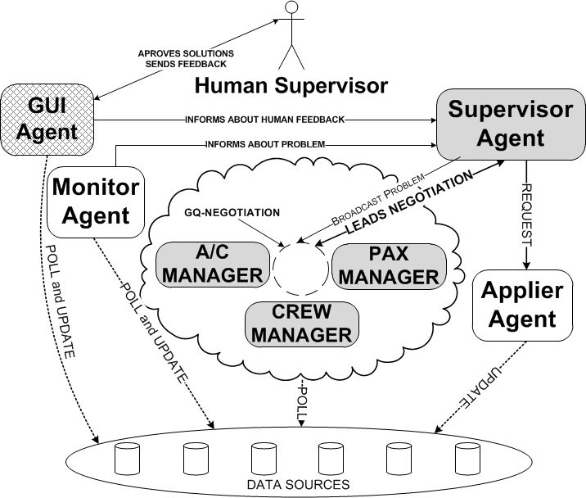
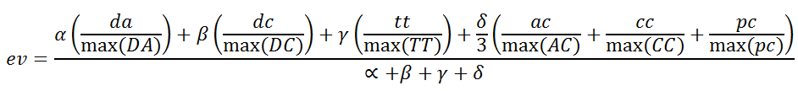
Cooperative Scenario : Negotiating solutions
MASDIMA – MAS for Disruption Management:
  Manager Agents collect solutions using different Algorithms.
  Agents are Experts in each one of the Dimensions
da, dc, tt: aircraft delay, crew delay passenger trip time;
ac, cc, pc: aircraft cost, crew costs, passenger cost of a specific proposal.
Notes:
plans happen to fail due to unexpected events. This is
what often happens with Airline Operations Control Centres
when trying to fulfil their obligations in the presence of unexpected
events, disruptions, that affect previously established
flights schedule plan.
Decrease in 2 or 3% of the airline annual revenue.

Slide 13
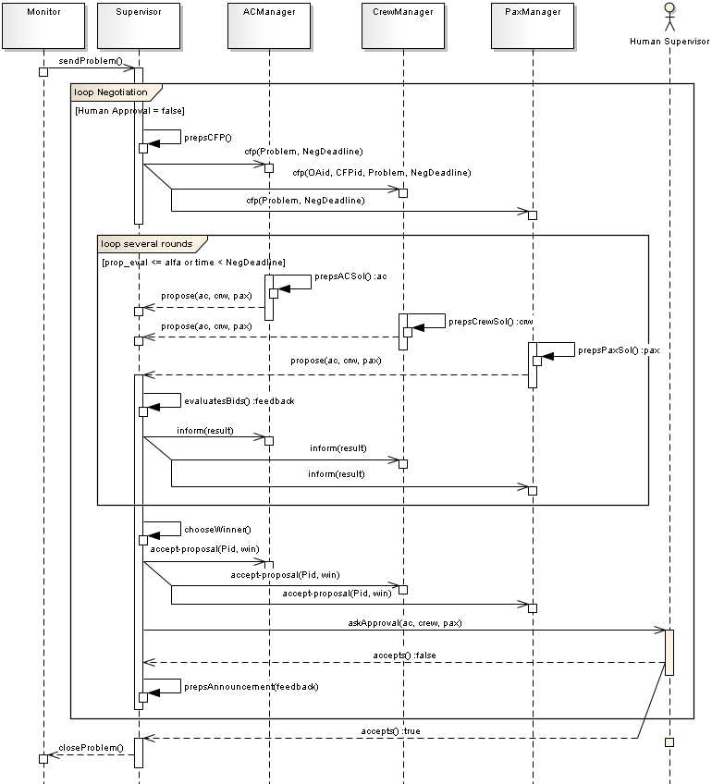
Manager-level Negotiation:
Cooperative Scenario:
Q-Negotiation
CFP
Proposals
Eval+
Qualitative feedback
Decision
(winner)

Slide 14
MASDIMA
Multi-Agent System
for Disruption Management
E. Oliveira + A. Castro

Slide 15
Competitive Scenario: Trust under Normative Environments
Agents represent different alternatives to answer the same question /
solve the same problem
Agents have to select among different alternatives
Structured (open and distributed) Environments:
      Enforces Normative behaviour
      Provides Trust indicators
Acknowledgement is due to H. Lopes Cardoso, J. Urbano, A.P.Rocha, P. Brandão
Notes:
Competitive scenaria are those in which Agents have to compete for being selected among other alternatives
There is a need for a structured environment .
Computational trust is a hot topic of research in distributed artificial intelligence. Whenever one is accepting an invitation in a social network,
exploring a new opportunity with an unknown partner using an e-procurement application, buying a product in an electronic auction
in the Internet, or relying on a non-corporative web service or some other grid resource, a trust decision is involved.

Slide 16
Competitive Scenario: Trust under Normative Environments
Examples:
  Cyber-Physical Systems (e.g. Social Networks relationships)
  B2B operations
B2B Scenario:
  Selecting enterprise partners for establishing e-Contracts
Notes:
- Cyber-physical systems (CPS) are engineered systems that are built from and depend upon the synergy of computational and physical components.
- One of the main breakthroughs of intelligent software
automation has been achieved in the B2B domains. Due to
globalization and constant delocalization, big multi-national
companies always try to re-design virtual consortia they belong
to, whenever a new opportunity of business arises. This fact
points out to the need of software systems that makes it
possible finding out the best potential partners to establish
temporary contracts leading to fruitful collaboration.

Slide 17
ANTE: Agreement Negotiation in Normative and Trust-enabled Environments
Work by H. Lopes Cardoso, J. Urbano, P. Brandão, A.P.Rocha, Eugénio Oliveira
Notes:
ANTE is a PLATFORM we have developed for Agreement Negotiation in Normative and Trust-enabled Environments

Slide 18
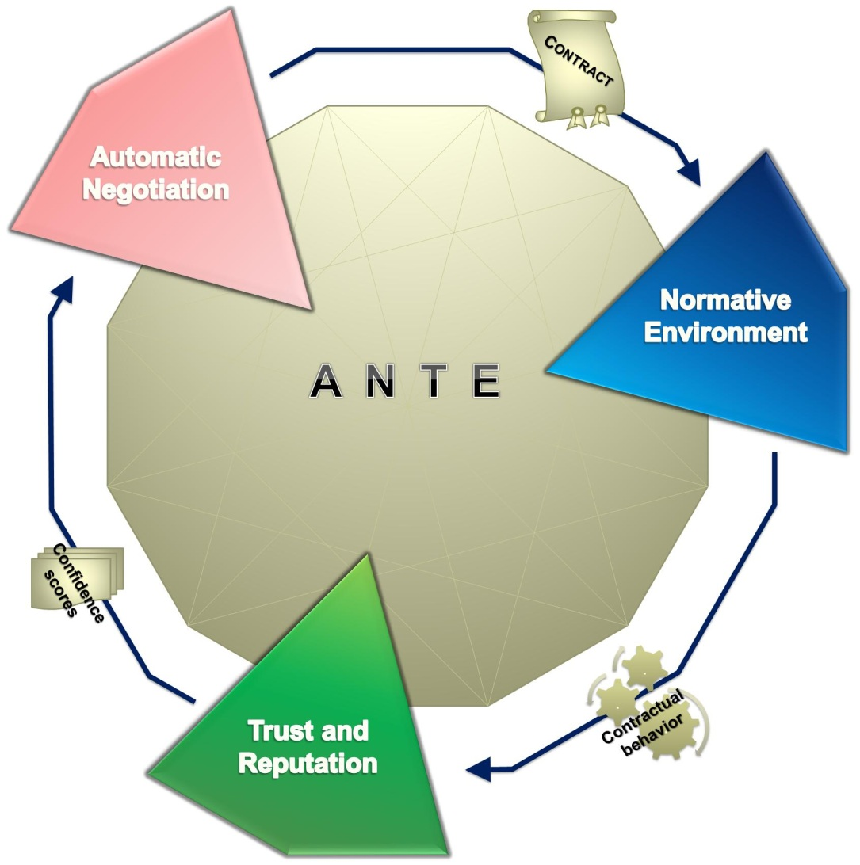
The ANTE framework
Notes:
ANTE includes different modules for reaching CONTRACTS and for monitoring them under a Normative Environment. This NE provides then information that can be used for updating Agents TRUST which, in turn is useful for the future Negotiations

Slide 19
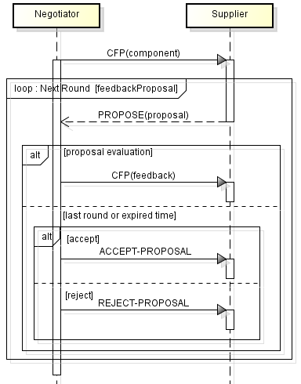
Automatic Negotiation
Negotiation-mediation service
  Q-Negotiation protocol for partner selection
    Multi-attribute negotiation
    Qualitative feedback
    Information privacy
    Learning while negotiating
  Trust-aware contract negotiation
    Pre-selection
    Proposal evaluation
    Contract drafting

Slide 20
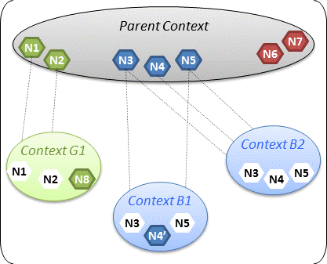
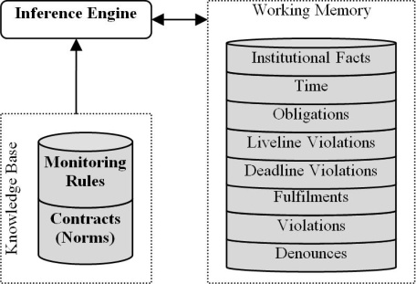

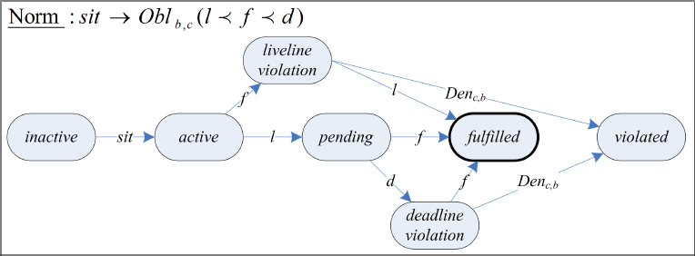
Normative Environment
Normative framework
  Hierarchical structure facilitating contract establishment
  Context-related Norms
Contract monitoring and enforcement
  Rule-based engine
  Contractual obligations
    Directed obligations within time windows
  Deterrence Fines
Notes:
Fines or penalties / sanctions can be applied in order to prevent agents from violating contractual clauses

Slide 21
Computational Trust
Trust as an additional enforcement mechanism for social order control
Computation of confidence scores using:
  Dynamics of trust
    Asymmetry, maturity, distinguishably in trust building
  Contextual fitness
    How fit is a business partner to a specific business opportunity?
Most recent research:
  Distinguish different trustworthiness factors: ability, benevolence (and integrity)
    TR(i, j, a, tr) = TW(i, j, a, tw) * as(i, j, a)
Contextual Fitness
Sinalpha
as(i,j,a) or Discount Factor is ≤ 1
Notes:
Most recent research: to include in next step of trust model of ANTE:
---→ trust of i in j for agreement a is given by the perceived trustworthiness of j, as seen by i, multiplied by a discount factor concerning the agreement satisfaction. This, in our current experiments, allow to distinguish a bit between ability and benevolence.
When aggregating the outcomes of every piece of evidence, the semantics of the relationship
should be taken into consideration whenever it is possible.
trust model allows the trustor to estimate the benevolence of the trustee toward him, in
order to have a more clear perception of the ability of the trustee in performing the agreed task and of his willingness in performing the task. This estimated benevolence will then act as a discount factor to be multiplied by the trustworthiness score as computed by a traditional
aggregation engine.

Slide 22
Scenario
B2B: Textile industry
Negotiated items: chiffon, cotton, …
  Attributes: quantity, price, delivery time
Contract of sale
  Delivery obligation (supplier) → Payment obligation (buyer)
ANTE
Buyers
  Preferences over attributes
  May use trustworthiness assessments
Suppliers
  Different contractual behaviors
    Fulfillment, delayed fulfillment, violation

Slide 23
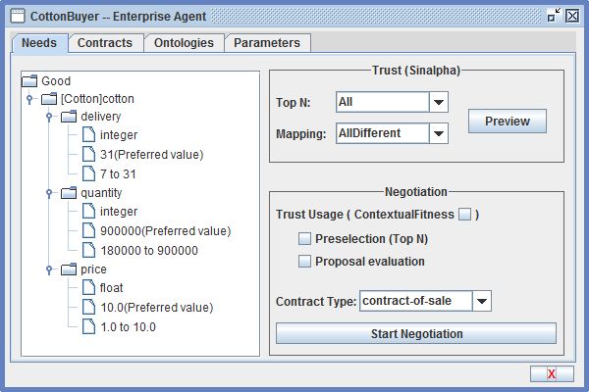
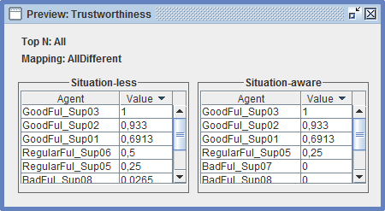
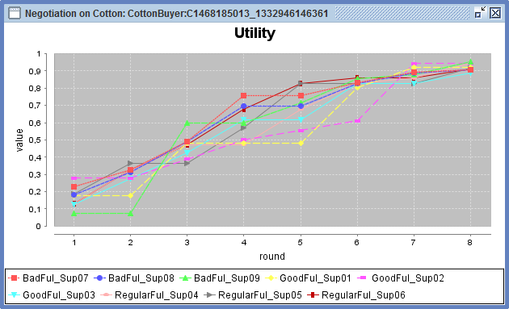

Slide 24
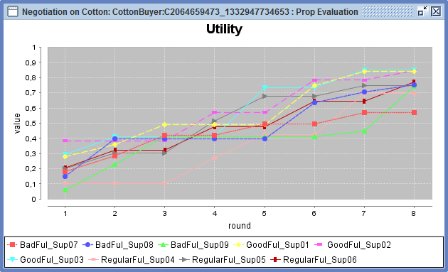

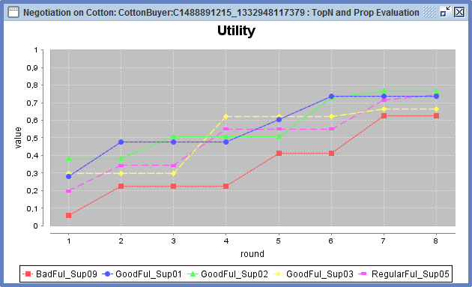


Slide 25
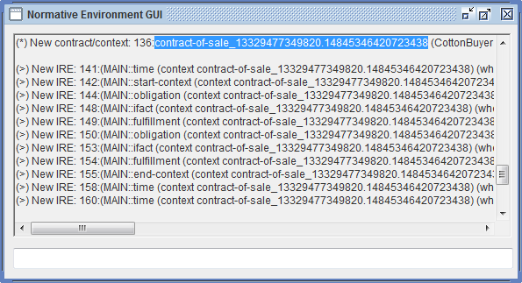
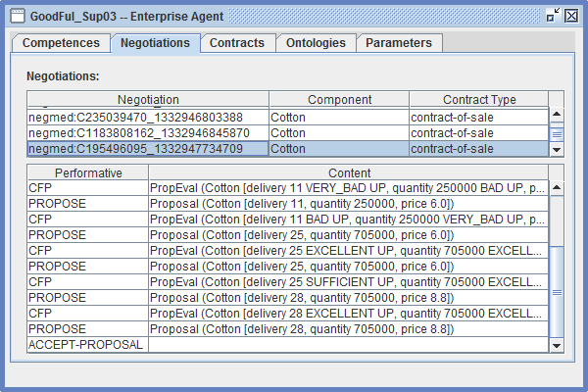
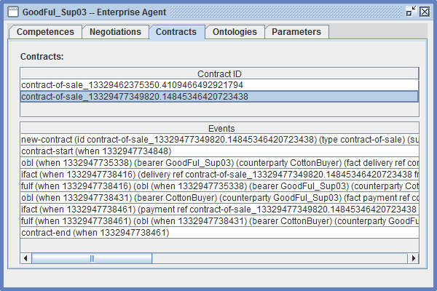

Slide 26
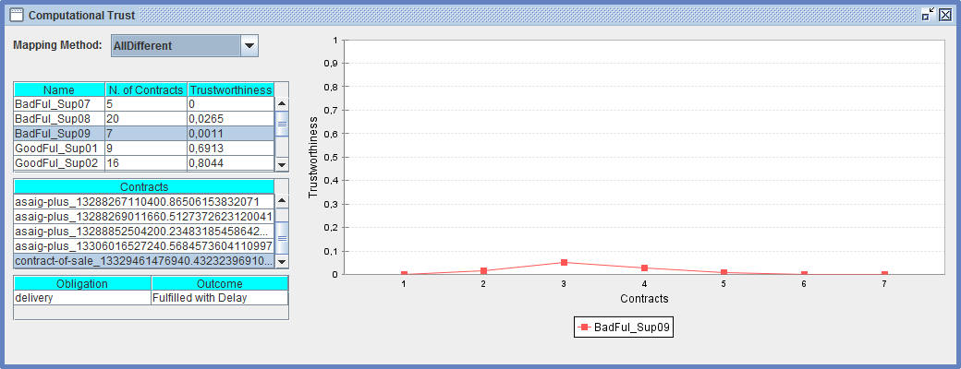
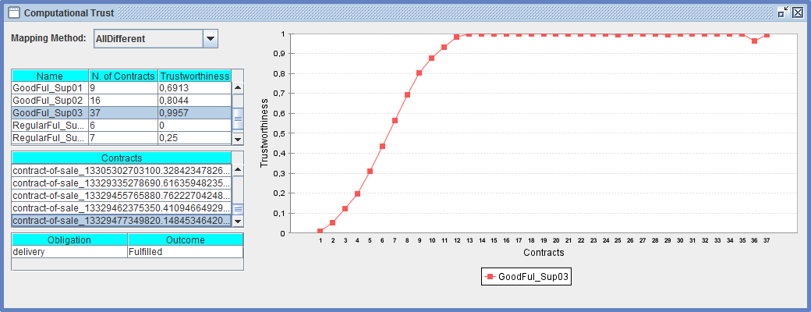

Slide 27
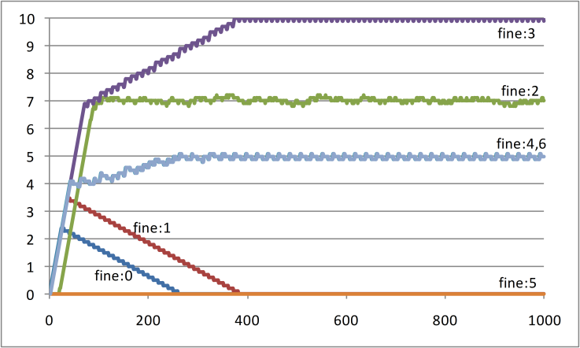
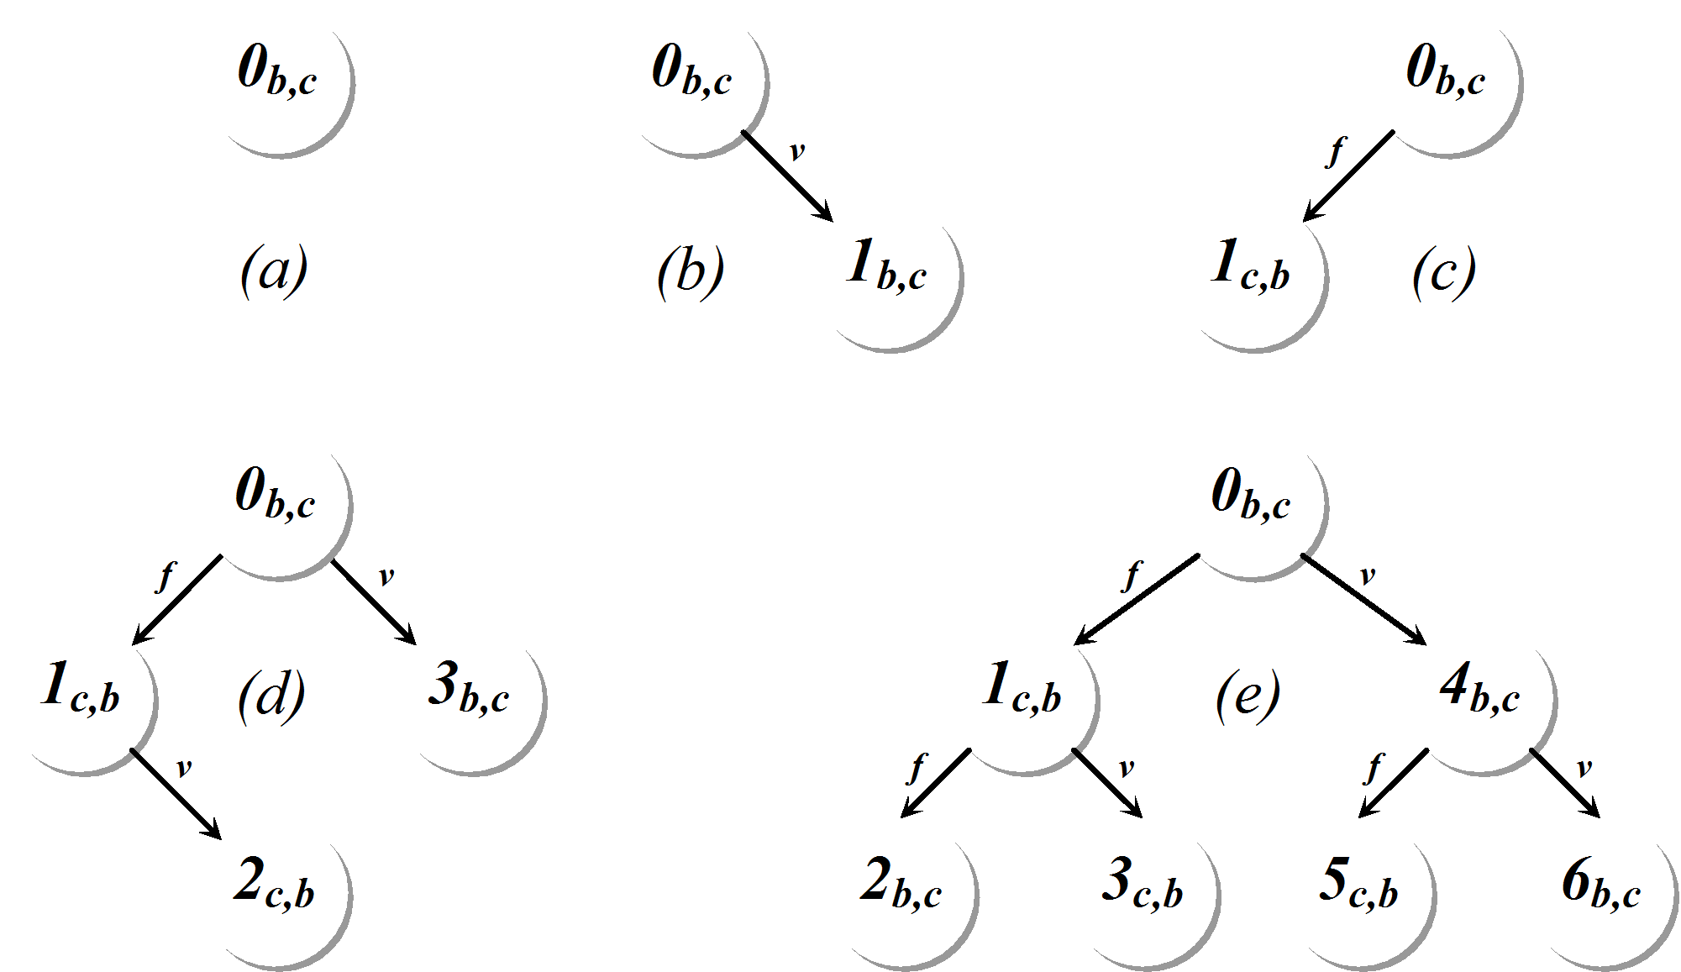
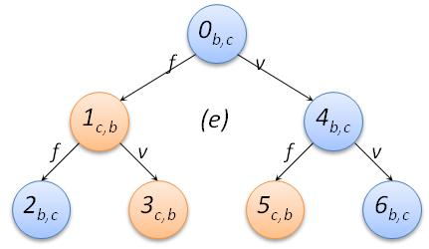
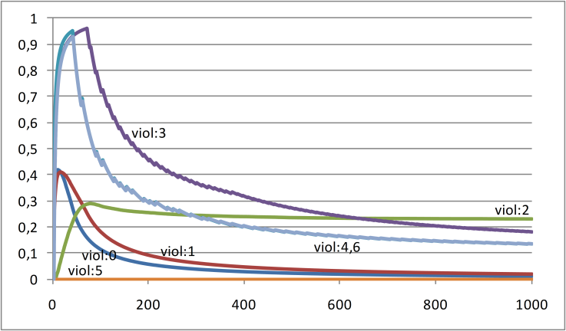
Adaptation
Simple update policy
  Increase FINES if number of tolerated violations is exceeded
Notes:
The Society as a all may impose FINES whenever norms are violated in excess. These FINES dynamically change their values according to a certain policy.
However, in order to avoid undisirable and Unjustifiable High Fines, they automatically adapt depending on the agents beheviour.
Moreover, Less violations may decrease Fines ‘ VALUES. They are interrelated.

Slide 28
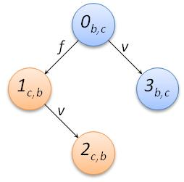
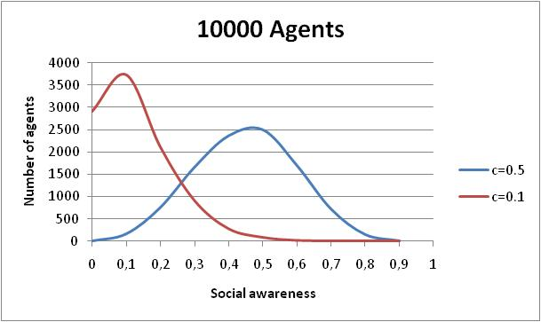
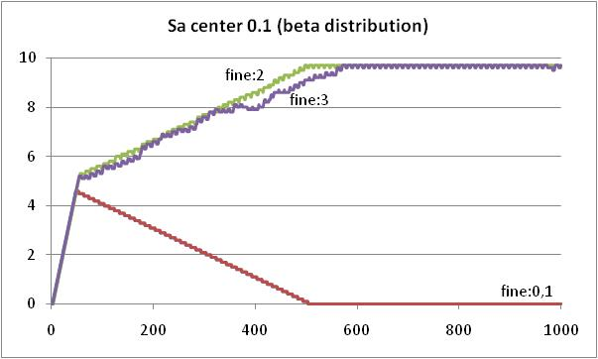
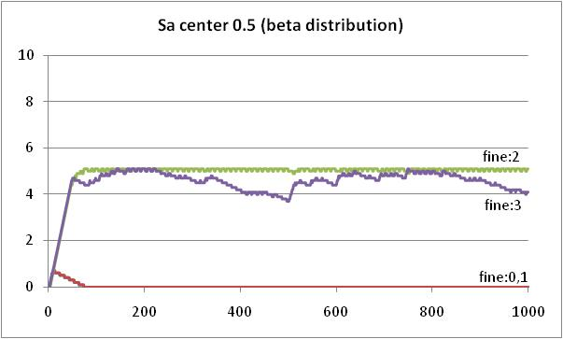
Different Agent Populations
Social awareness beta distributions

Slide 29
ANTE Platform
  An Agent-based platform combining different agreement technologies
    Negotiation, norms, trust, Ontologies, …
    combines trust and norms for contract establishment / monitoring
  A modular and extensible architecture (JADE-based)
    Negotiation protocols, trust engines, …
    User agents with different behaviors (negotiation strategies, trust usage policies, contractual behavior)

Slide 30
Conclusions
MAS is a useful paradigm for DDD kind of Problems
If we make available:
Negotiation protocols
Normative Environments
Computational Trust-based Mechanisms
….

Slide 31
INFORMATION EXTRACTION
TWITTER METER

Slide 32
Twitómetro
Online tool that allows to infer the so-called “sentiment “of Portuguese Twitter users (about the 5 most representative candidates for the 2011 Portuguese elections)
The analysis is based on:
  the identification of the political targets in the messages (NER);
  Detection of the “sentiment” polarity (positive of negative) of each message towards an identified target.
Available at http://legislativas.sapo.pt/2011/twitometro/

Slide 33
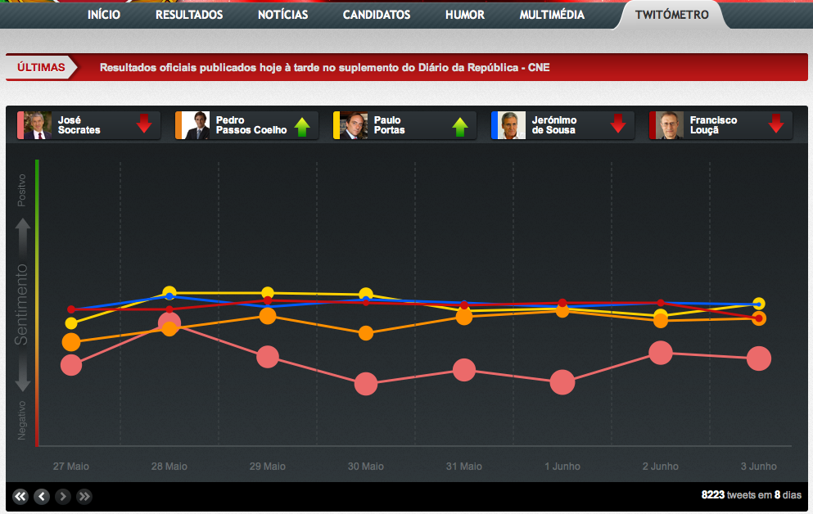
Twitómetro
Five candidates
Sentiment Scale

Slide 34
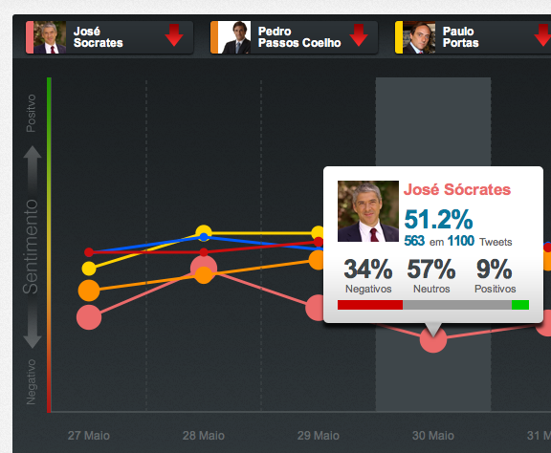
Twitómetro
Details about one candidate
51% of all tweets with targets from this day (1100) refer to José Sócrates
9% of the tweets about this target are positive, and 34% are negative

Slide 35
MVDI – “Mundo Visto Daqui”
World seen from here
Interactive tool that allows to detect and visualize relations between people mentioned on news.
How does it works:
  Identify names of people on news (occurrences)
  Establish relations between people (co-occurrences)
  Build an “individual-centric” network of relations on a specific time interval
Weekly basis online publication (SAPO)
MVDI is focused on Portuguese news at http://voxx.sapo.pt/mvdi

Slide 36
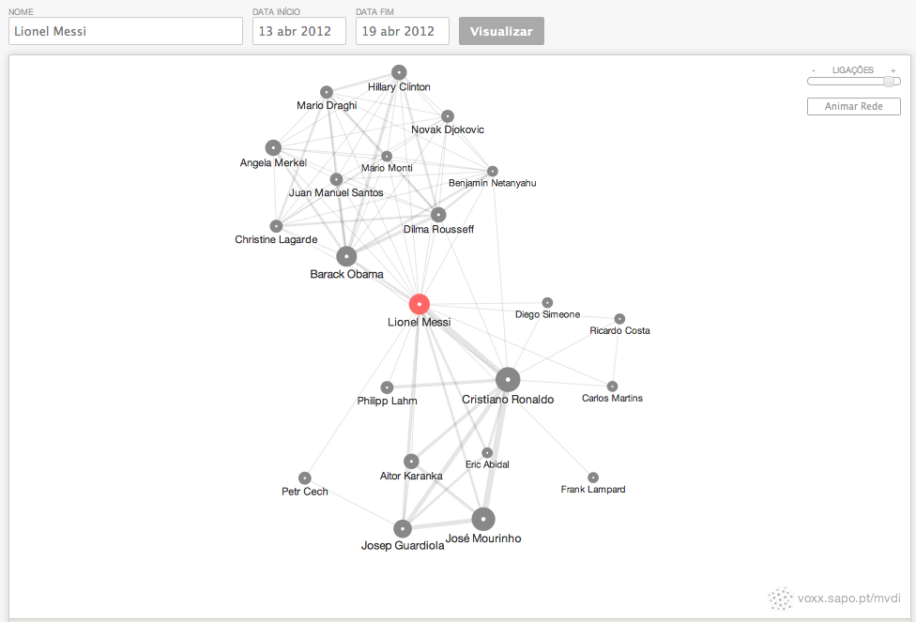
MVDI – “Mundo Visto Daqui”
Choose any name and date interval
Non-football related people
Ego – Lionel Messi
Strong relations with football players and coaches

Slide 37
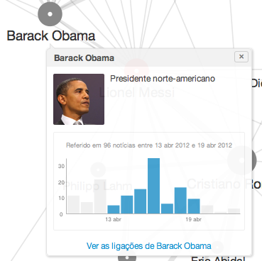
MVDI – “Mundo Visto Daqui”
Details about any node (person) from the network
Job descriptor
Activity (occurrences) on news

Slide 38
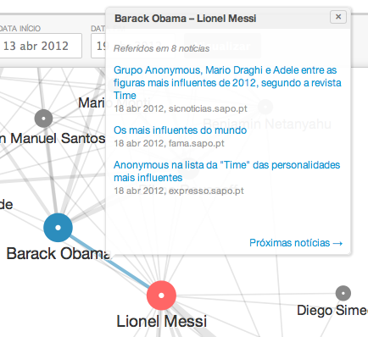
MVDI – “Mundo Visto Daqui”
Why is Lionel Messi related with Barack Obama?
Both appear on news related to a list published by “Time” of the most influent people in 2012.

Slide 39
THANK YOU!

