Slide 1
A Building Automation Case Study Setup and Challenges
João Cambeiro, Cláudio Gomes, Vasco Amaral, Armanda Rodrigues and Jácome Cunha
SEsCPS 2018 Gothenburg
NOVA LINCS Research Laboratory (Grant: FCT/MCTES PEst UID/ CEC/04516/2013)

Slide 2
Building Automation Systems
Building Automation Systems are Cyber-Physical Systems instances built for:
Maximisation of building occupants comfort
Energy consumption optimisation
Implementation of access control and security policies
Building energy consumption is responsible for 30 – 45% of global energy consumption

Slide 3
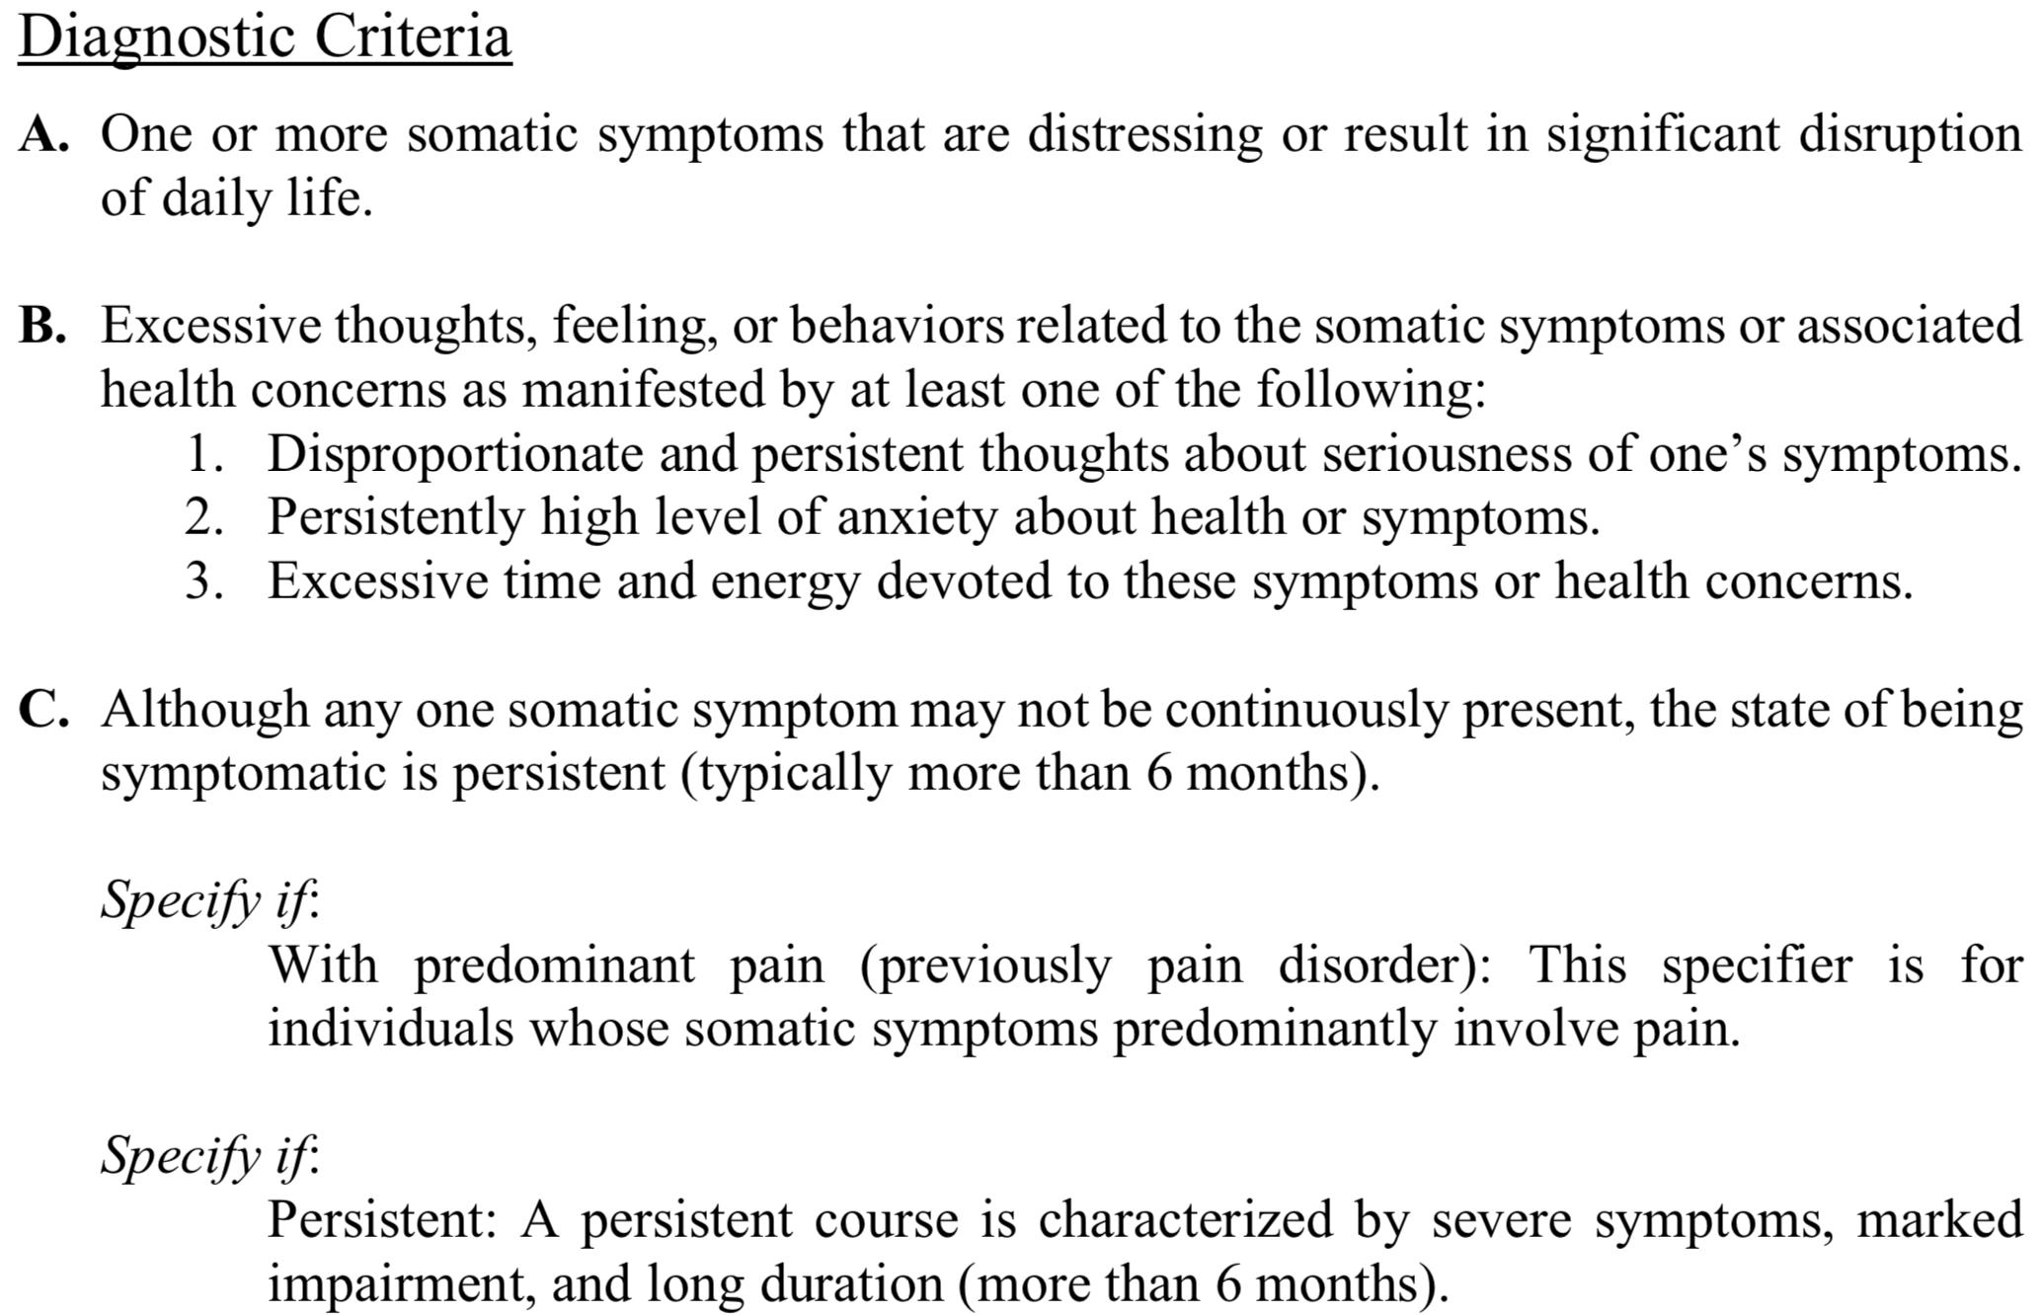
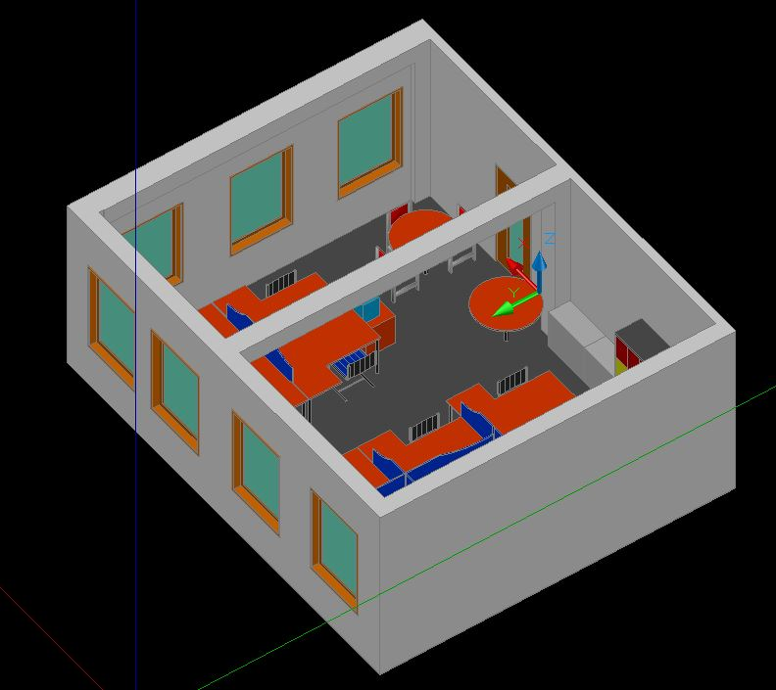
Multi-Paradigm Modelling
CPS Megamodel
Generated Artifacts

Slide 4
Case Study - Goals
Streamline the development process of systems, where humans play different roles in the system, using model-driven techniques.
Development of obfuscation techniques that ensure the privacy of the occupants.
Foster new research by making the collected data and control interfaces publicly available in the context of the MPM4CPS COST Action

Slide 5
Case Study – Physical Setup
Systems:
Computer Science laboratory
Fish tank
The available sensors are:
Temperature
Light
Power
Indoor Positioning System
The available actuators are:
Power sockets
Lights
AC unit
Windows and blinds
Notes:
Individual occupants preferences and potential conflicts need to be accomodated

Slide 6
Case Study – The Fish-in-the-Loop
Sensors:
Temperature
Conductivity
Water level
pH
Actuators:
Feeder
Water heater
Water cooler
Water pump
Lights
5L of water lost due to evaporation every week

Slide 7
PHYSICAL
Humans
Temperature
Light
Location
Water temperature
pH level
Power and current sensors
COMPUTATION
Sensors
Control
Actuators
Plant
Humans
WSO2 IOT Server
Agents – Embedded System
Open Aquarium
Humans
Fish Tank
Structural Elements
FEEDBACK LOOP
Humans
Lights
Power Sockets
Heater
Air Conditioning
Coffee Machine
Fish Feeder
Water ventilator
Water heater

Slide 8
User engagement - Gamification
Over time, user engagement decay was observed.
Gamification techniques are being implemented with the objective of keeping the room occupants engaged.

Slide 9
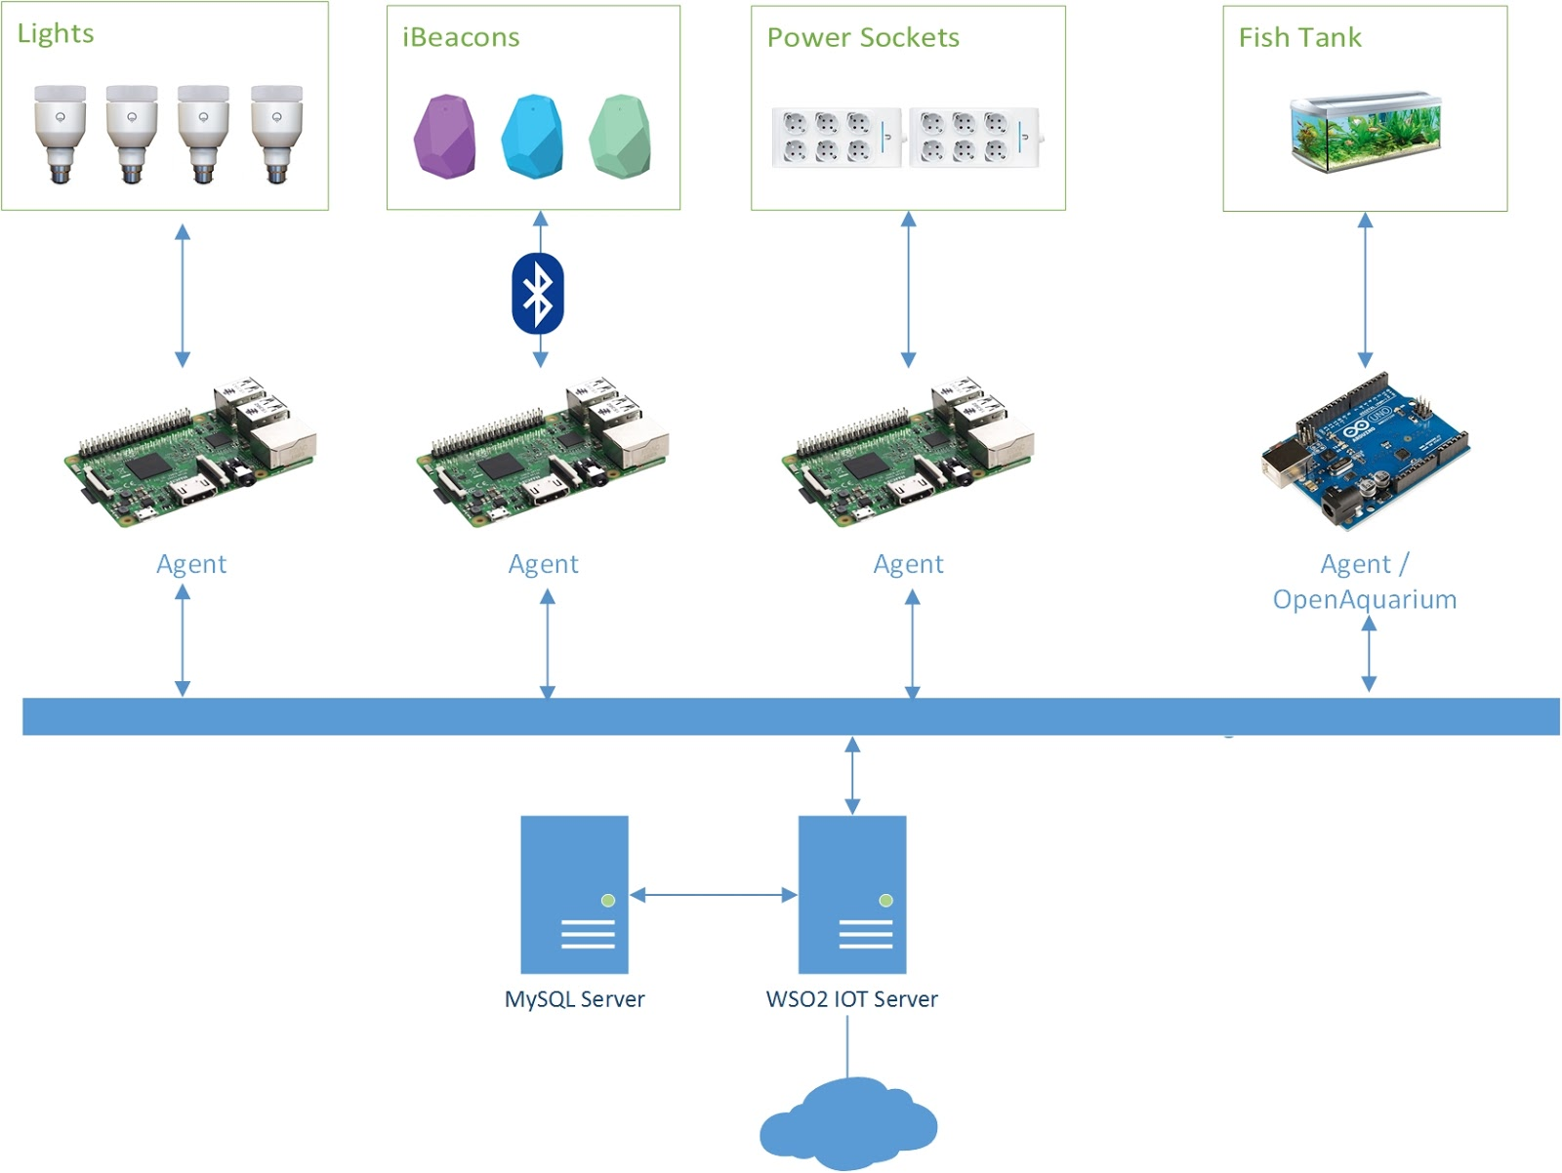
Overview Architecture

Slide 10
Ongoing Work – Physical Model
Applications:
Data source used by simulation tools
Visualisation Tools
Deployment Guides
Management
Reporting

Slide 11
Ongoing Work - Metamodel

Slide 12
Ongoing Work – Feature Model

Slide 13
Future Work
Implementation of DSLs capable of generating tests, documentation and a control rules set
Deployment of novel simulation techniques
Research advanced control systems
Application of gamification techniques to achieve a higher user engagement
Notes:
Dsls para geração de testes, documentação. Simulação antes e durante a execução (objectivo suportar diferentes parâmetros de configuração e objectivos do Sistema)

Slide 14
Thank you

Slide 15
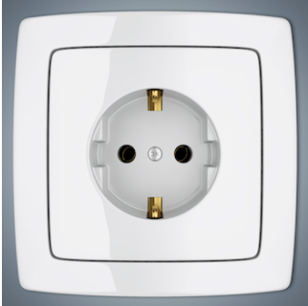
Data – Energy Consumption

Slide 16
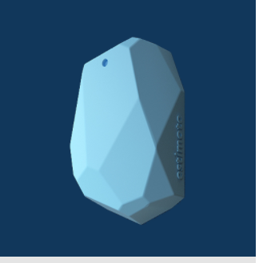
Data – Temperature

Slide 17
Data – Light Levels

Slide 18
WSO2 IOT Components Overview

